Slide 1
STL Geometry: Blood Flow in Intracranial Aneurysm
黃薪橙
洪仕軒 教授
Date : 2025/8/26

Slide 2
Outline
Introduction
Problem Description
Case Setup
Importing the required packages
Using STL files to generate point clouds
Defining the Equations, Networks and Nodes
Setting up Domain and adding Constraints
Adding Validators and Monitors
Training Model
Accelerating the Training of Neural Network Solvers via Transfer Learning
Demo

Slide 3
File Overview
Code
aneurysm.py
cloud_point_vtp.py
config.yaml
Data
aneurysm_parabolicInlet_sol0.csv
stl_files
aneurysm_closed.stl
aneurysm_inlet.stl
aneurysm_integral.stl
aneurysm_noslip.stl
aneurysm_outlet.stl

Slide 4
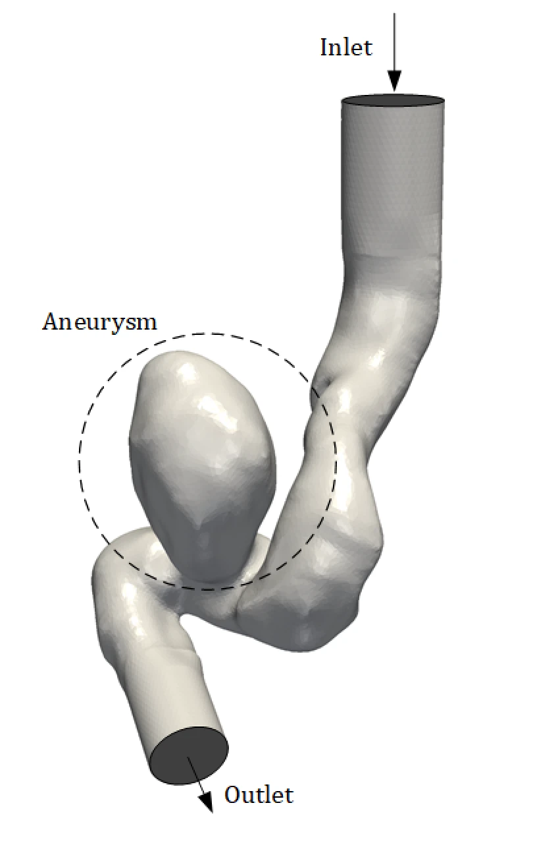
Introduction
Import an STL file.
Use PhysicsNeMo Sym’ SDF library to sample points on surface and interior.
Train the PINNs to predict flow.

Slide 5
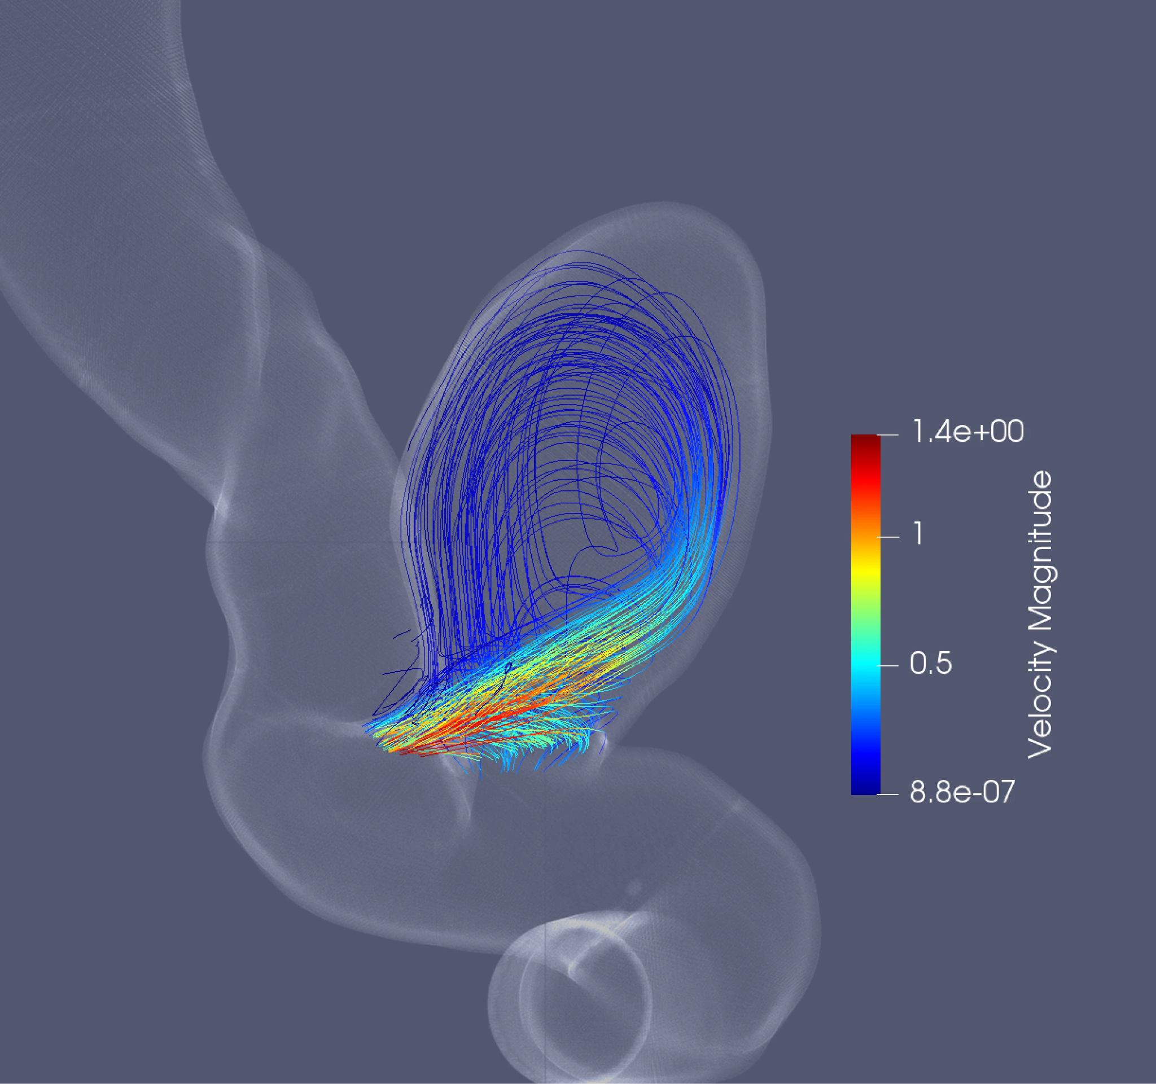
Problem Description
Predict its internal velocity distribution and pressure under given inlet conditions, fluid parameters, STL boundary and constraints.

Slide 6
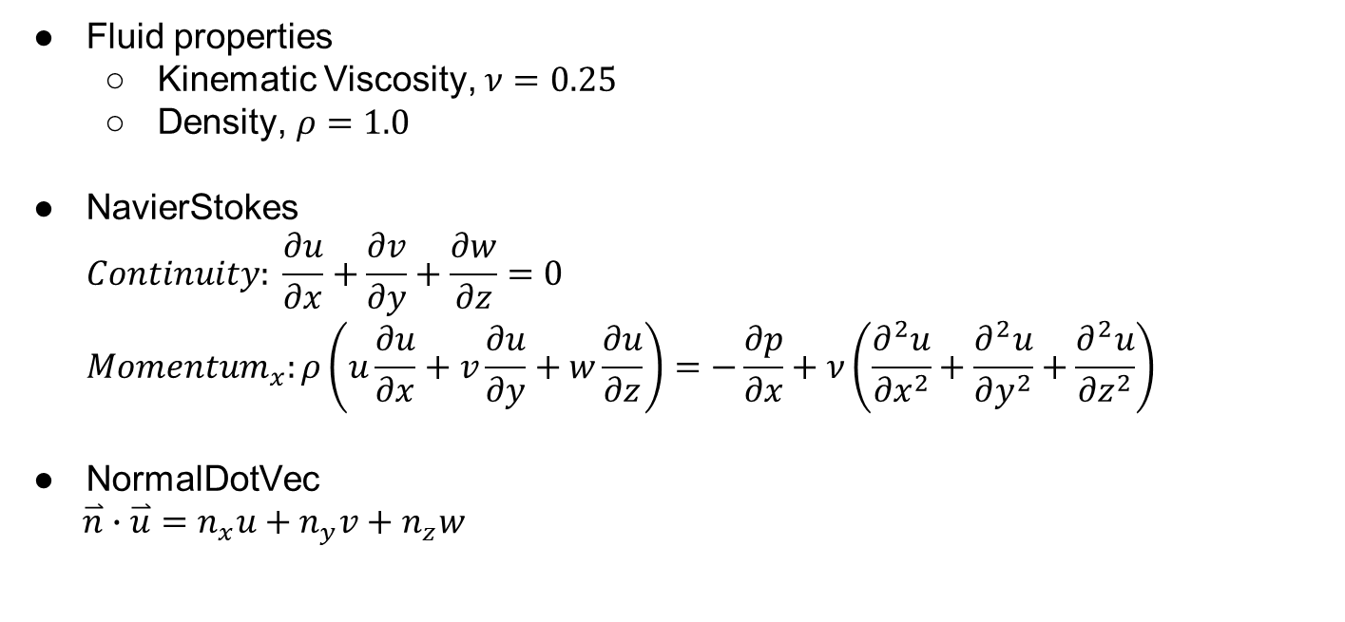
Problem Description
Fluid properties
Kinematic Viscosity, $ν=0.25$
Density, $ρ=1.0$
NavierStokes
$$Continuity: \frac{∂u}{∂x}+\frac{∂v}{∂y}+\frac{∂w}{∂z}=0$$
$${Momentum}_{x}:ρ\left(u\frac{∂u}{∂x}+v\frac{∂u}{∂y}+w\frac{∂u}{∂z}\right)=−\frac{∂p}{∂x}+ν\left(\frac{∂^{2}u}{∂x^{2}}+\frac{∂^{2}u}{∂y^{2}}+\frac{∂^{2}u}{∂z^{2}}\right)$$
NormalDotVec
$\overset{⃑}{n}∙\overset{⃑}{u}=n_{x}u+n_{y}v+n_{z}w$

Slide 7
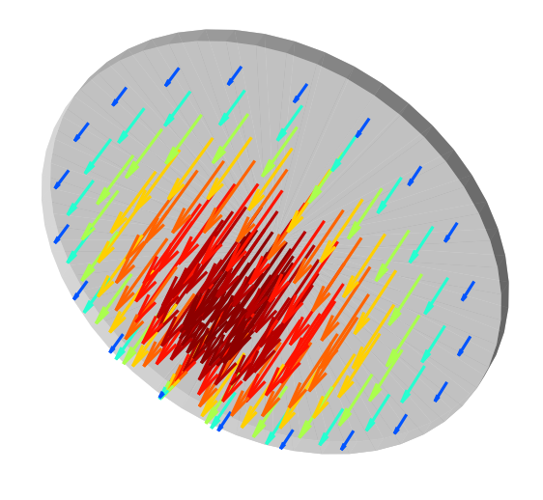
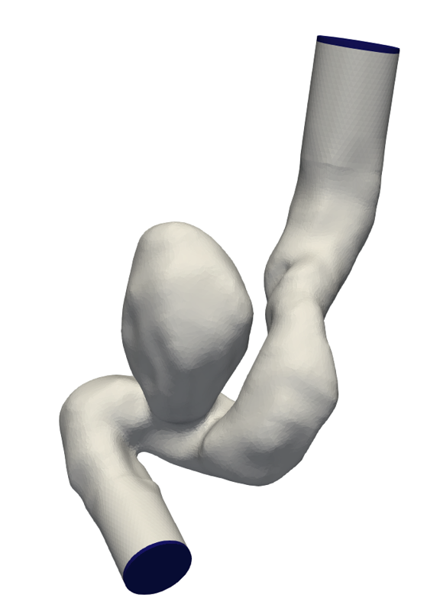
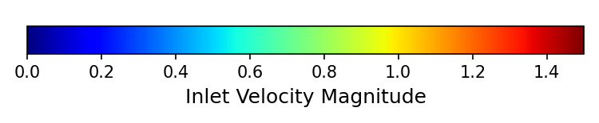
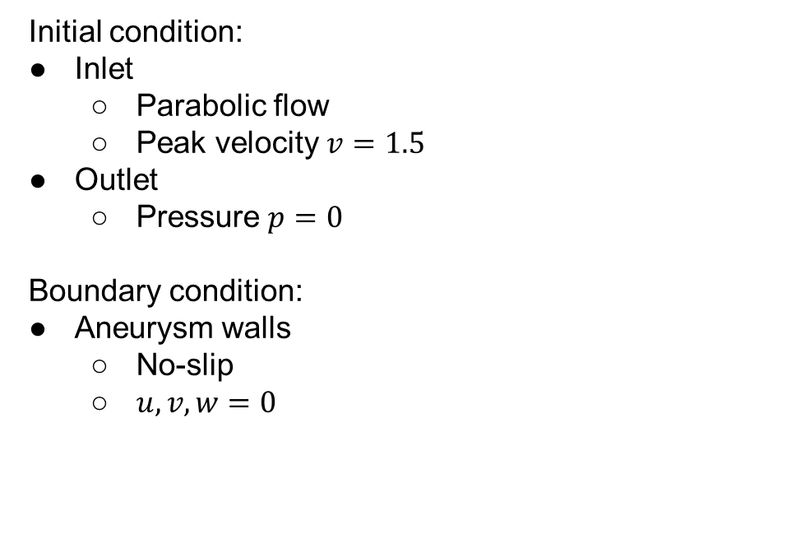
Problem Description
Inlet
Initial condition:
Inlet
Parabolic flow
Peak velocity $v=1.5$
Outlet
Pressure $p=0$
Boundary condition:
Aneurysm walls
No-slip
$u, v, w=0$

Slide 8
Case Setup
Importing the required packages

Slide 9
Importing the required packages
import os
import warnings
import torch
import numpy as np
from sympy import Symbol, sqrt, Max
import physicsnemo.sym
from physicsnemo.sym.hydra import to_absolute_path, instantiate_arch, PhysicsNeMoConfig
from physicsnemo.sym.solver import Solver
from physicsnemo.sym.domain import Domain
from physicsnemo.sym.domain.constraint import (
PointwiseBoundaryConstraint,
PointwiseInteriorConstraint,
IntegralBoundaryConstraint,
)
from physicsnemo.sym.domain.validator import PointwiseValidator
from physicsnemo.sym.domain.monitor import PointwiseMonitor
from physicsnemo.sym.key import Key
from physicsnemo.sym.eq.pdes.navier_stokes import NavierStokes
from physicsnemo.sym.eq.pdes.basic import NormalDotVec
from physicsnemo.sym.utils.io import csv_to_dict
from physicsnemo.sym.geometry.tessellation import Tessellation
Using constraints on boundary and interior sampling points.
Using Tessellation package to sample points on boundary or interior of given model.
aneurysm.py

Slide 10
Case Setup
Using STL files to generate point clouds

Slide 11
Using STL files to generate point clouds
@physicsnemo.sym.main(config_path="conf", config_name="config")
def run(cfg: PhysicsNeMoConfig) -> None:
# read stl files to make geometry
point_path = to_absolute_path("./stl_files")
inlet_mesh = Tessellation.from_stl(
point_path + "/aneurysm_inlet.stl", airtight=False
)
outlet_mesh = Tessellation.from_stl(
point_path + "/aneurysm_outlet.stl", airtight=False
)
noslip_mesh = Tessellation.from_stl(
point_path + "/aneurysm_noslip.stl", airtight=False
)
integral_mesh = Tessellation.from_stl(
point_path + "/aneurysm_integral.stl", airtight=False
)
interior_mesh = Tessellation.from_stl(
point_path + "/aneurysm_closed.stl", airtight=True
)
# params
nu = 0.025
inlet_vel = 1.5
Import STL model and specify each model is open or closed.
aneurysm.py

Slide 12
Using STL files to generate point clouds
@physicsnemo.sym.main(config_path="conf", config_name="config")
def run(cfg: PhysicsNeMoConfig) -> None:
# read stl files to make geometry
point_path = to_absolute_path("./stl_files")
inlet_mesh = Tessellation.from_stl(
point_path + "/aneurysm_inlet.stl", airtight=False
)
outlet_mesh = Tessellation.from_stl(
point_path + "/aneurysm_outlet.stl", airtight=False
)
noslip_mesh = Tessellation.from_stl(
point_path + "/aneurysm_noslip.stl", airtight=False
)
integral_mesh = Tessellation.from_stl(
point_path + "/aneurysm_integral.stl", airtight=False
)
interior_mesh = Tessellation.from_stl(
point_path + "/aneurysm_closed.stl", airtight=True
)
# params
nu = 0.025
inlet_vel = 1.5
“False” means STL is open.
“True” means STL is closed.
aneurysm.py

Slide 13
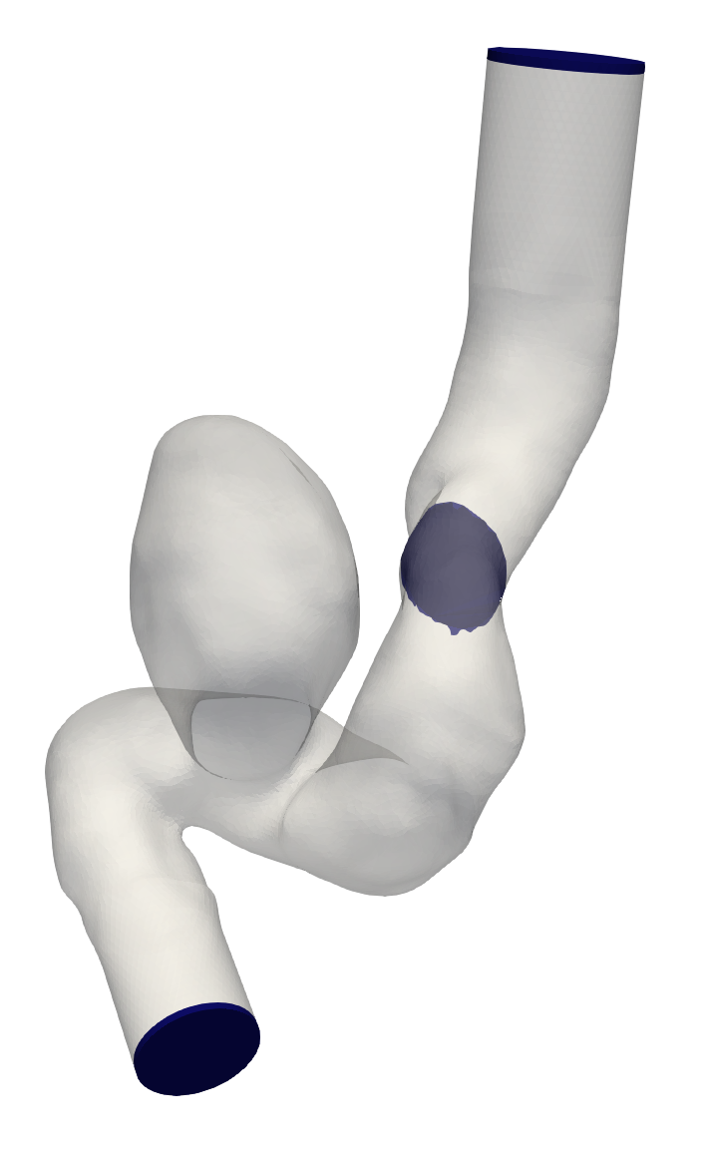
Using STL files to generate point clouds
@physicsnemo.sym.main(config_path="conf", config_name="config")
def run(cfg: PhysicsNeMoConfig) -> None:
# read stl files to make geometry
point_path = to_absolute_path("./stl_files")
inlet_mesh = Tessellation.from_stl(
point_path + "/aneurysm_inlet.stl", airtight=False
)
outlet_mesh = Tessellation.from_stl(
point_path + "/aneurysm_outlet.stl", airtight=False
)
noslip_mesh = Tessellation.from_stl(
point_path + "/aneurysm_noslip.stl", airtight=False
)
integral_mesh = Tessellation.from_stl(
point_path + "/aneurysm_integral.stl", airtight=False
)
interior_mesh = Tessellation.from_stl(
point_path + "/aneurysm_closed.stl", airtight=True
)
# params
nu = 0.025
inlet_vel = 1.5
aneurysm.py

Slide 14
Using STL files to generate point clouds
@physicsnemo.sym.main(config_path="conf", config_name="config")
def run(cfg: PhysicsNeMoConfig) -> None:
# read stl files to make geometry
point_path = to_absolute_path("./stl_files")
inlet_mesh = Tessellation.from_stl(
point_path + "/aneurysm_inlet.stl", airtight=False
)
outlet_mesh = Tessellation.from_stl(
point_path + "/aneurysm_outlet.stl", airtight=False
)
noslip_mesh = Tessellation.from_stl(
point_path + "/aneurysm_noslip.stl", airtight=False
)
integral_mesh = Tessellation.from_stl(
point_path + "/aneurysm_integral.stl", airtight=False
)
interior_mesh = Tessellation.from_stl(
point_path + "/aneurysm_closed.stl", airtight=True
)
# params
nu = 0.025
inlet_vel = 1.5
aneurysm.py

Slide 15
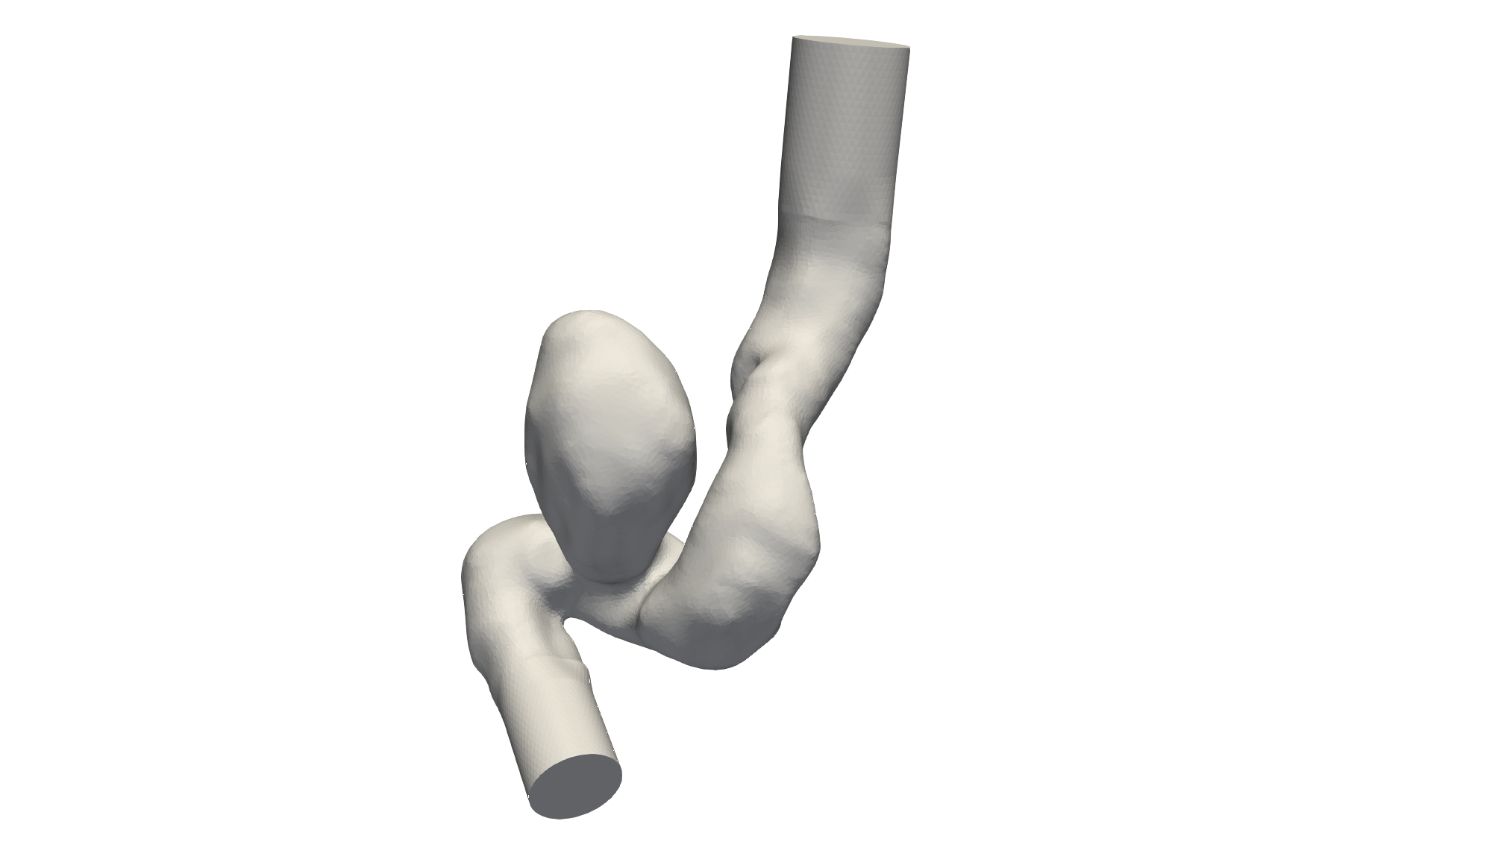
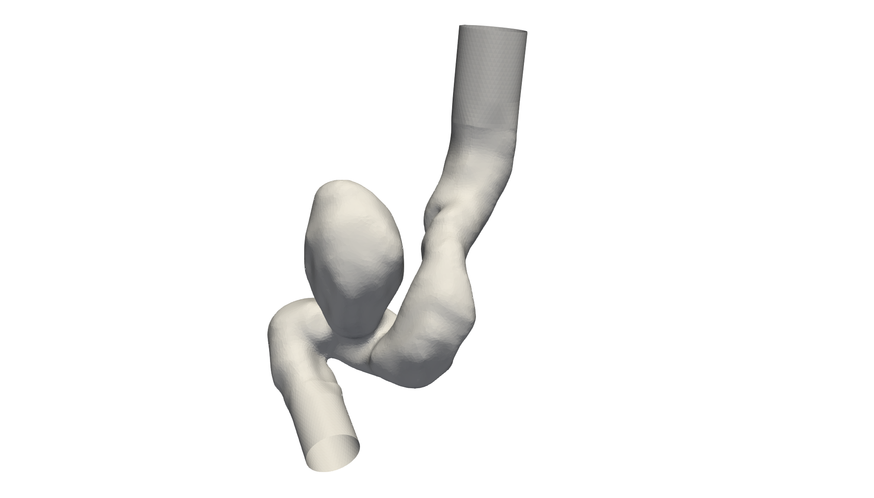
STL object
aneurysm_closed.stl
aneurysm_noslip.stl
Interior
closed
open

Slide 16
Tessellation sample point
import numpy as np
from physicsnemo.sym.geometry.tessellation import Tessellation
from physicsnemo.sym.utils.io.vtk import var_to_polyvtk
if __name__ == "__main__":
# STL path
stl_path = "real_stl_files/aneurysm_closed.stl"
geo = Tessellation.from_stl(stl_path, airtight=True)
# number of points to sample
nr_points = 100000
# sample geometry for plotting in Paraview
s = geo.sample_boundary(nr_points=nr_points)
var_to_polyvtk(s, "aneurysm_closed_boundary")
print("Surface Area: {:.3f}".format(np.sum(s["area"])))
# Only generating cloud point
s = geo.sample_interior(nr_points=nr_points, compute_sdf_derivatives=False)
var_to_polyvtk(s, "aneurysm_closed_interior")
print("Volume: {:.3f}".format(np.sum(s["area"])))
Number of sample points
cloud_point_vtp.py

Slide 17
Tessellation sample point
import numpy as np
from physicsnemo.sym.geometry.tessellation import Tessellation
from physicsnemo.sym.utils.io.vtk import var_to_polyvtk
if __name__ == "__main__":
# STL path
stl_path = "real_stl_files/aneurysm_closed.stl"
geo = Tessellation.from_stl(stl_path, airtight=True)
# number of points to sample
nr_points = 100000
# sample geometry for plotting in Paraview
s = geo.sample_boundary(nr_points=nr_points)
var_to_polyvtk(s, "aneurysm_closed_boundary")
print("Surface Area: {:.3f}".format(np.sum(s["area"])))
# Only generating cloud point
s = geo.sample_interior(nr_points=nr_points, compute_sdf_derivatives=False)
var_to_polyvtk(s, "aneurysm_closed_interior")
print("Volume: {:.3f}".format(np.sum(s["area"])))
Sample boundary on STL
Sample interior on STL
cloud_point_vtp.py

Slide 18
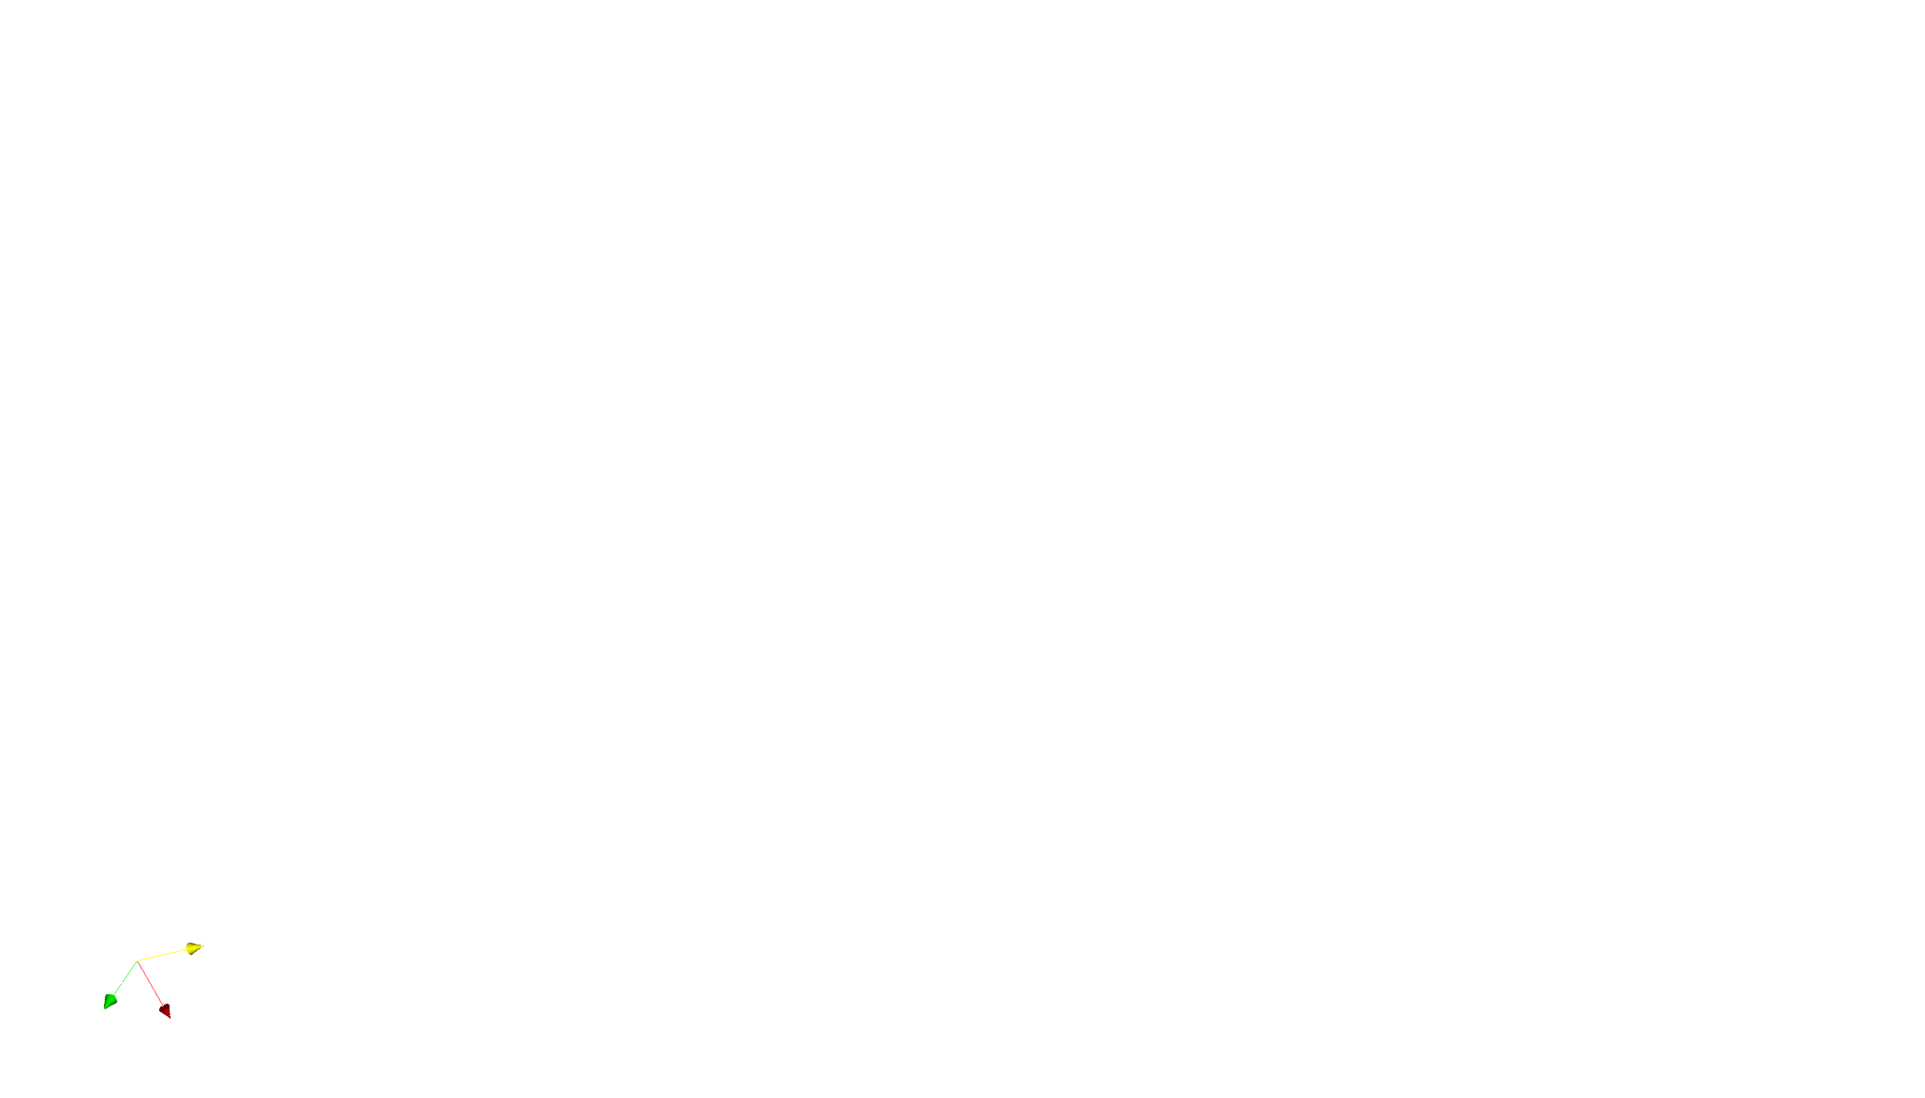
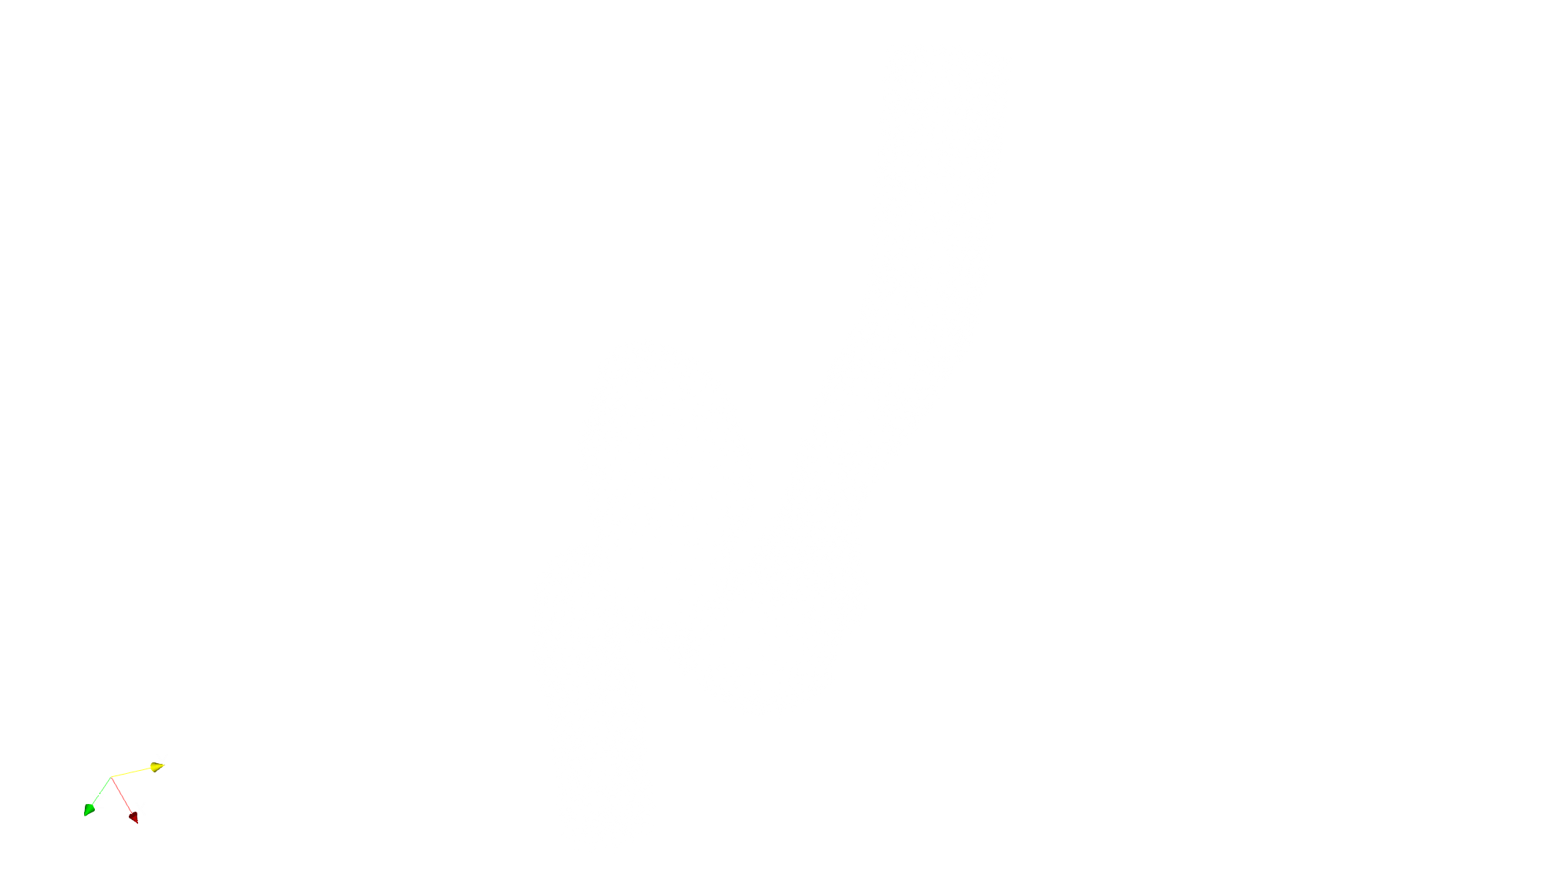
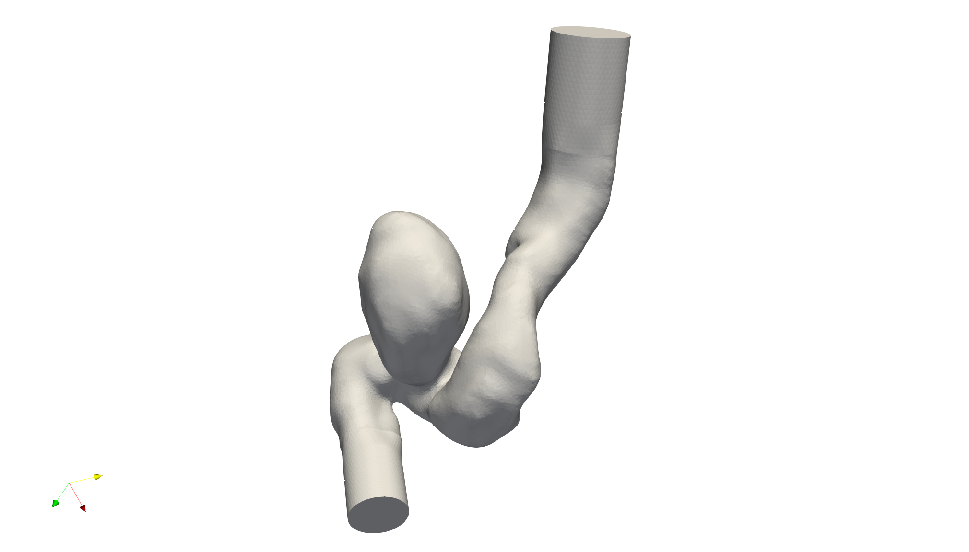
Tessellation sample point view
Geometry
Boundary
Interior

Slide 19
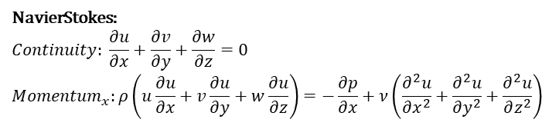
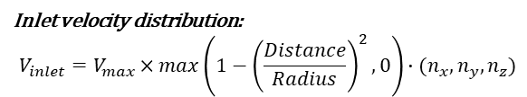
Parameters
@physicsnemo.sym.main(config_path="conf", config_name="config")
def run(cfg: PhysicsNeMoConfig) -> None:
# read stl files to make geometry
point_path = to_absolute_path("./stl_files")
inlet_mesh = Tessellation.from_stl(
point_path + "/aneurysm_inlet.stl", airtight=False
)
outlet_mesh = Tessellation.from_stl(
point_path + "/aneurysm_outlet.stl", airtight=False
)
noslip_mesh = Tessellation.from_stl(
point_path + "/aneurysm_noslip.stl", airtight=False
)
integral_mesh = Tessellation.from_stl(
point_path + "/aneurysm_integral.stl", airtight=False
)
interior_mesh = Tessellation.from_stl(
point_path + "/aneurysm_closed.stl", airtight=True
)
# params
nu = 0.025
inlet_vel = 1.5
NavierStokes:
$$Continuity: \frac{∂u}{∂x}+\frac{∂v}{∂y}+\frac{∂w}{∂z}=0$$
$${Momentum}_{x}:ρ\left(u\frac{∂u}{∂x}+v\frac{∂u}{∂y}+w\frac{∂u}{∂z}\right)=−\frac{∂p}{∂x}+ν\left(\frac{∂^{2}u}{∂x^{2}}+\frac{∂^{2}u}{∂y^{2}}+\frac{∂^{2}u}{∂z^{2}}\right)$$
Inlet velocity distribution:
$$V_{inlet}=V_{max}×max\left(1−{\left(\frac{Distance}{Radius}\right)}^{2}, 0\right)∙(n_{x},n_{y},n_{z})$$
aneurysm.py

Slide 20
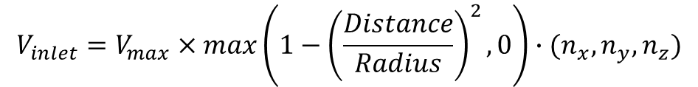
Inlet velocity
Parabolic velocity distribution for a circular inlet.
# inlet velocity profile
def circular_parabola(x, y, z, center, normal, radius, max_vel):
centered_x = x - center[0]
centered_y = y - center[1]
centered_z = z - center[2]
distance = sqrt(centered_x**2 + centered_y**2 + centered_z**2)
parabola = max_vel * Max((1 - (distance / radius) ** 2), 0)
return normal[0] * parabola, normal[1] * parabola, normal[2] * parabola
aneurysm.py
$$V_{inlet}=V_{max}×max\left(1−{\left(\frac{Distance}{Radius}\right)}^{2}, 0\right)∙(n_{x},n_{y},n_{z})$$

Slide 21
Normalize geometry
# normalize meshes
def normalize_mesh(mesh, center, scale):
mesh = mesh.translate([-c f7or c in center])
mesh = mesh.scale(scale)
return mesh
# normalize invars
def normalize_invar(invar, center, scale, dims=2):
invar["x"] -= center[0]
invar["y"] -= center[1]
invar["z"] -= center[2]
invar["x"] *= scale
invar["y"] *= scale4
invar["z"] *= scale
if "area" in invar.keys():
invar["area"] *= scale**dims
return invar
Normalizing mesh data (STL file) toward (0,0,0)
Normalizing Dictionary data toward the (0,0,0)
aneurysm.py

Slide 22
Normalize geometry
# scale and normalize mesh and openfoam data
center = (-18.40381048596882, -50.285383353981196, 12.848136936899031)
scale = 0.4
inlet_mesh = normalize_mesh(inlet_mesh, center, scale)
outlet_mesh = normalize_mesh(outlet_mesh, center, scale)
noslip_mesh = normalize_mesh(noslip_mesh, center, scale)
integral_mesh = normalize_mesh(integral_mesh, center, scale)
interior_mesh = normalize_mesh(interior_mesh, center, scale)
# geom params
inlet_normal = (0.8526, -0.428, 0.299)
inlet_area = 21.1284 * (scale**2)
inlet_center = (-4.24298030045776, 4.082857101816247, -4.637790193399717)
inlet_radius = np.sqrt(inlet_area / np.pi)
outlet_normal = (0.33179, 0.43424, 0.83747)
outlet_area = 12.0773 * (scale**2)
outlet_radius = np.sqrt(outlet_area / np.pi)
Scale each mesh data and setup geometry parameters for constraints.
aneurysm.py

Slide 23
Case Setup
Defining the Equations, Networks and Nodes

Slide 24
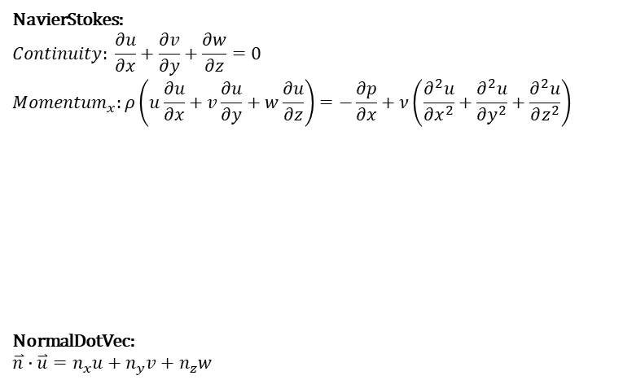
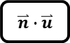
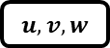
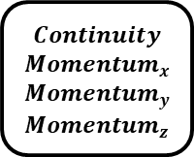
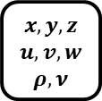
Setup PDE
# make aneurysm domain
domain = Domain()
# make list of nodes to unroll graph on
ns = NavierStokes(nu=nu * scale, rho=1.0, dim=3, time=False)
normal_dot_vel = NormalDotVec(["u", "v", "w"])
flow_net = instantiate_arch(
input_keys=[Key("x"), Key("y"), Key("z")],
output_keys=[Key("u"), Key("v"), Key("w"), Key("p")],
cfg=cfg.arch.fully_connected,
)
nodes = (
ns.make_nodes()
+ normal_dot_vel.make_nodes()
+ [flow_net.make_node(name="flow_network")]
)
NavierStokes:
$$Continuity: \frac{∂u}{∂x}+\frac{∂v}{∂y}+\frac{∂w}{∂z}=0$$
$${Momentum}_{x}:ρ\left(u\frac{∂u}{∂x}+v\frac{∂u}{∂y}+w\frac{∂u}{∂z}\right)=−\frac{∂p}{∂x}+ν\left(\frac{∂^{2}u}{∂x^{2}}+\frac{∂^{2}u}{∂y^{2}}+\frac{∂^{2}u}{∂z^{2}}\right)$$
NormalDotVec:
$$\overset{⃑}{n}∙\overset{⃑}{u}=n_{x}u+n_{y}v+n_{z}w$$
$$Continuity$$
$${Momentum}_{x}$$
$${Momentum}_{y}$$
$${Momentum}_{z}$$
$$x, y,z$$
$$u,v,w$$
$$ρ, ν$$
NavierStokes
aneurysm.py
$$u,v,w$$
NormalDotVec
$$\overset{⃑}{n}∙\overset{⃑}{u}$$

Slide 25
Setup Network
# make aneurysm domain
domain = Domain()
# make list of nodes to unroll graph on
ns = NavierStokes(nu=nu * scale, rho=1.0, dim=3, time=False)
normal_dot_vel = NormalDotVec(["u", "v", "w"])
flow_net = instantiate_arch(
input_keys=[Key("x"), Key("y"), Key("z")],
output_keys=[Key("u"), Key("v"), Key("w"), Key("p")],
cfg=cfg.arch.fully_connected,
)
nodes = (
ns.make_nodes()
+ normal_dot_vel.make_nodes()
+ [flow_net.make_node(name="flow_network")]
)
Fully connected network
512
u
x
v
y
w
z
p
aneurysm.py
6 layers

Slide 26
Setup Nodes
Node
# make aneurysm domain
domain = Domain()
# make list of nodes to unroll graph on
ns = NavierStokes(nu=nu * scale, rho=1.0, dim=3, time=False)
normal_dot_vel = NormalDotVec(["u", "v", "w"])
flow_net = instantiate_arch(
input_keys=[Key("x"), Key("y"), Key("z")],
output_keys=[Key("u"), Key("v"), Key("w"), Key("p")],
cfg=cfg.arch.fully_connected,
)
nodes = (
ns.make_nodes()
+ normal_dot_vel.make_nodes()
+ [flow_net.make_node(name="flow_network")]
)
PDE
NavierStokes
PDE
NormalDotVec
aneurysm.py
NN
Flow_network

Slide 27
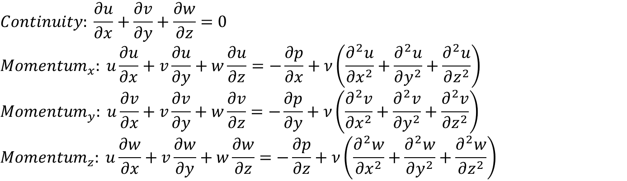
NavierStoke
The NavierStokes class defines the governing equations for incompressible fluid flow in 3D.
$$Continuity: \frac{∂u}{∂x}+\frac{∂v}{∂y}+\frac{∂w}{∂z}=0$$
$${Momentum}_{x}: u\frac{∂u}{∂x}+v\frac{∂u}{∂y}+w\frac{∂u}{∂z}=−\frac{∂p}{∂x}+ν\left(\frac{∂^{2}u}{∂x^{2}}+\frac{∂^{2}u}{∂y^{2}}+\frac{∂^{2}u}{∂z^{2}}\right)$$
$${Momentum}_{y}: u\frac{∂v}{∂x}+v\frac{∂v}{∂y}+w\frac{∂v}{∂z}=−\frac{∂p}{∂y}+ν\left(\frac{∂^{2}v}{∂x^{2}}+\frac{∂^{2}v}{∂y^{2}}+\frac{∂^{2}v}{∂z^{2}}\right)$$
$${Momentum}_{z}: u\frac{∂w}{∂x}+v\frac{∂w}{∂y}+w\frac{∂w}{∂z}=−\frac{∂p}{∂z}+ν\left(\frac{∂^{2}w}{∂x^{2}}+\frac{∂^{2}w}{∂y^{2}}+\frac{∂^{2}w}{∂z^{2}}\right)$$

Slide 28
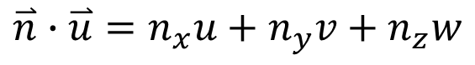
NormalDotVec
The NormalDotVec class computes the dot product between the predicted velocity vector and the local surface normal vector.
$$\overset{⃑}{n}∙\overset{⃑}{u}=n_{x}u+n_{y}v+n_{z}w$$

Slide 29
Case Setup
Setting up Domain and adding Constraints

Slide 30
Constraints for inlet
# inlet
u, v, w = circular_parabola(
Symbol("x"),
Symbol("y"),
Symbol("z"),
center=inlet_center,
normal=inlet_normal,
radius=inlet_radius,
max_vel=inlet_vel,
)
inlet = PointwiseBoundaryConstraint(
nodes=nodes,
geometry=inlet_mesh,
outvar={"u": u, "v": v, "w": w},
batch_size=cfg.batch_size.inlet,
)
domain.add_constraint(inlet, "inlet")
# outlet
outlet = PointwiseBoundaryConstraint(
nodes=nodes,
geometry=outlet_mesh,
outvar={"p": 0},
batch_size=cfg.batch_size.outlet,
)
domain.add_constraint(outlet, "outlet")

Slide 31
Constraints for outlet
# inlet
u, v, w = circular_parabola(
Symbol("x"),
Symbol("y"),
Symbol("z"),
center=inlet_center,
normal=inlet_normal,
radius=inlet_radius,
max_vel=inlet_vel,
)
inlet = PointwiseBoundaryConstraint(
nodes=nodes,
geometry=inlet_mesh,
outvar={"u": u, "v": v, "w": w},
batch_size=cfg.batch_size.inlet,
)
domain.add_constraint(inlet, "inlet")
# outlet
outlet = PointwiseBoundaryConstraint(
nodes=nodes,
geometry=outlet_mesh,
outvar={"p": 0},
batch_size=cfg.batch_size.outlet,
)
domain.add_constraint(outlet, "outlet")
p = 0

Slide 32
Constraints for no_slip
# no slip
no_slip = PointwiseBoundaryConstraint(
nodes=nodes,
geometry=noslip_mesh,
outvar={"u": 0, "v": 0, "w": 0},
batch_size=cfg.batch_size.no_slip,
)
domain.add_constraint(no_slip, "no_slip")
aneurysm.py
It enforces that the network satisfies the no-slip condition on vessel wall surface.

Slide 33
Constraints for interior
# interior
interior = PointwiseInteriorConstraint(
nodes=nodes,
geometry=interior_mesh,
outvar={"continuity": 0, "momentum_x": 0, "momentum_y": 0, "momentum_z": 0},
batch_size=cfg.batch_size.interior,
)
domain.add_constraint(interior, "interior")
aneurysm.py
It enforces that the network satisfies the incompressible Navier-Stokes equations throughout the interior.

Slide 34
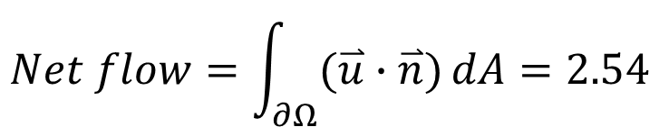
Constraints for outlet flow
# Integral Continuity 1
integral_continuity = IntegralBoundaryConstraint(
nodes=nodes,
geometry=outlet_mesh,
outvar={"normal_dot_vel": 2.540},
batch_size=1,
integral_batch_size=cfg.batch_size.integral_continuity,
lambda_weighting={"normal_dot_vel": 0.1},
)
domain.add_constraint(integral_continuity, "integral_continuity_1")
aneurysm.py
$$Net flow=\int_{∂Ω}{(\overset{⃑}{u}∙\overset{⃑}{n})}dA=2.54$$

Slide 35
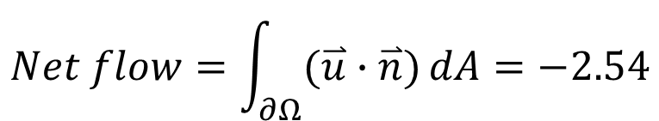
Constraints for integral mesh flow
# Integral Continuity 2
integral_continuity = IntegralBoundaryConstraint(
nodes=nodes,
geometry=integral_mesh,
outvar={"normal_dot_vel": -2.540},
batch_size=1,
integral_batch_size=cfg.batch_size.integral_continuity,
lambda_weighting={"normal_dot_vel": 0.1},
)
domain.add_constraint(integral_continuity, "integral_continuity_2")
aneurysm.py
$$Net flow=\int_{∂Ω}{(\overset{⃑}{u}∙\overset{⃑}{n})}dA=−2.54$$

Slide 36
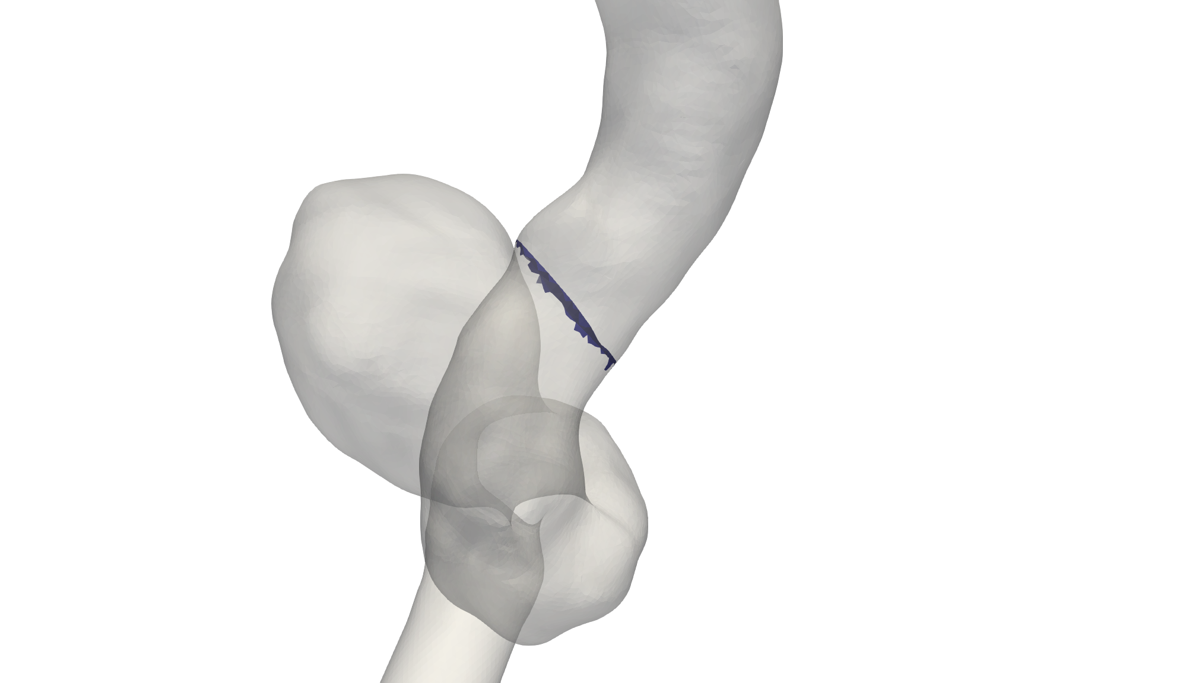
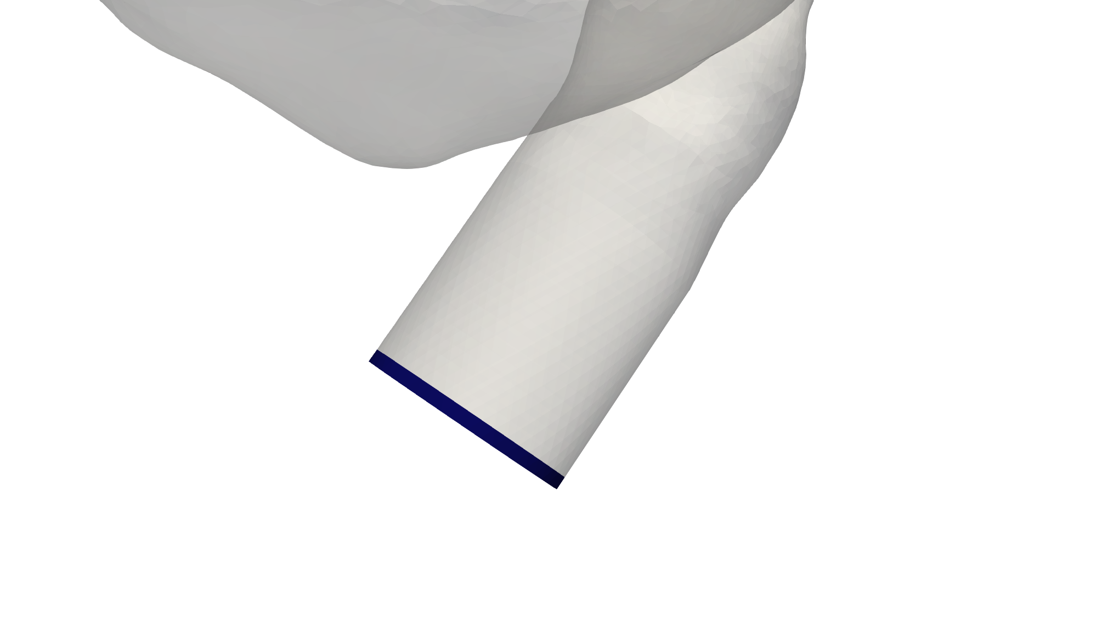
Why negative and positive sign
normal
flow
flow
normal
outlet flow
integral mesh flow

Slide 37
Case Setup
Adding Validators and Monitors

Slide 38
Adding Validators and Monitors
file_path = "./openfoam/aneurysm_parabolicInlet_sol0.csv"
if os.path.exists(to_absolute_path(file_path)):
mapping = {
"Points:0": "x",
"Points:1": "y",
"Points:2": "z",
"U:0": "u",
"U:1": "v",
"U:2": "w",
"p": "p",
}
openfoam_var = csv_to_dict(to_absolute_path(file_path), mapping)
openfoam_invar = {
key: value for key, value in openfoam_var.items() if key in ["x", "y", "z"]
}
openfoam_invar = normalize_invar(openfoam_invar, center, scale, dims=3)
openfoam_outvar = {
key: value
for key, value in openfoam_var.items()
if key in ["u", "v", "w", "p"]
}
Load ground truth dataset
aneurysm.py

Slide 39
Adding Validators and Monitors
file_path = "./openfoam/aneurysm_parabolicInlet_sol0.csv"
if os.path.exists(to_absolute_path(file_path)):
mapping = {
"Points:0": "x",
"Points:1": "y",
"Points:2": "z",
"U:0": "u",
"U:1": "v",
"U:2": "w",
"p": "p",
}
openfoam_var = csv_to_dict(to_absolute_path(file_path), mapping)
openfoam_invar = {
key: value for key, value in openfoam_var.items() if key in ["x", "y", "z"]
}
openfoam_invar = normalize_invar(openfoam_invar, center, scale, dims=3)
openfoam_outvar = {
key: value
for key, value in openfoam_var.items()
if key in ["u", "v", "w", "p"]
}
Normalize dataset and setup invar, outvar
aneurysm.py

Slide 40
Adding Validators and Monitors
openfoam_validator = PointwiseValidator(
nodes=nodes,
invar=openfoam_invar,
true_outvar=openfoam_outvar,
batch_size=4096,
)
domain.add_validator(openfoam_validator)
# add pressure monitor
pressure_monitor = PointwiseMonitor(
inlet_mesh.sample_boundary(16),
output_names=["p"],
metrics={"pressure_drop": lambda var: torch.mean(var["p"])},
nodes=nodes,
)
domain.add_monitor(pressure_monitor)
# make solver
slv = Solver(cfg, domain)
# start solver
slv.solve()
Setup validator to compare the result with ground truth data
aneurysm.py

Slide 41
Adding Validators and Monitors
openfoam_validator = PointwiseValidator(
nodes=nodes,
invar=openfoam_invar,
true_outvar=openfoam_outvar,
batch_size=4096,
)
domain.add_validator(openfoam_validator)
# add pressure monitor
pressure_monitor = PointwiseMonitor(
inlet_mesh.sample_boundary(16),
output_names=["p"],
metrics={"pressure_drop": lambda var: torch.mean(var["p"])},
nodes=nodes,
)
domain.add_monitor(pressure_monitor)
# make solver
slv = Solver(cfg, domain)
# start solver
slv.solve()
Setup monitor to randomly sample 16 points on inlet mesh and then trace pressure
aneurysm.py

Slide 42
Training Model

Slide 43
Training Model
defaults :
- physicsnemo_default
- arch:
- fully_connected
- scheduler: tf_exponential_lr
- optimizer: adam
- loss: sum
- _self_
scheduler:
decay_rate: 0.95
decay_steps: 15000
training:
rec_results_freq : 10000
rec_constraint_freq: 50000
max_steps : 1500000
batch_size:
inlet: 512
outlet: 512
no_slip: 2048
interior: 4096
integral_continuity: 310
After 50,000 steps, the time per 100 steps increased from under 1 minute to over 10 minutes.The issue was resolved after removing rec_constraint_freq setting.
Start training:
$python aneurysm.py
config.yaml

Slide 44
Training Model
defaults :
- physicsnemo_default
- arch:
- fully_connected
- scheduler: tf_exponential_lr
- optimizer: adam
- loss: sum
- _self_
scheduler:
decay_rate: 0.95
decay_steps: 15000
training:
rec_results_freq : 10000
rec_constraint_freq: 50000
max_steps : 1500000
batch_size:
inlet: 512 #1100
outlet: 512 #650
no_slip: 2048 #5200
interior: 4096 #6000
integral_continuity: 310 #310
The batch_size settings define how many points are sampled for each constraint, and adjust the size to a smaller value can speed up model training.
Start training:
$python aneurysm.py
config.yaml

Slide 45
Experiment
 | aneurysm.py
CPU | Intel Ultra 7 265F
GPU | RTX 5070
Max_step | 1,500,000
Time | 3 day 7 hr

Slide 46
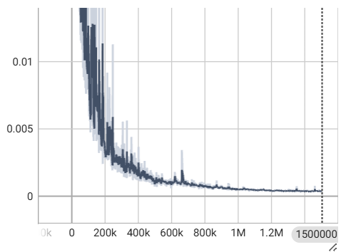
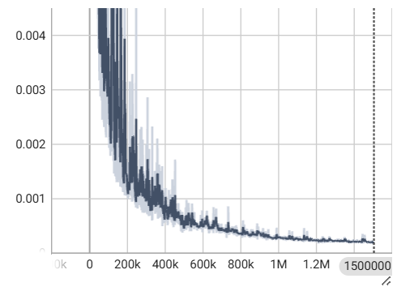
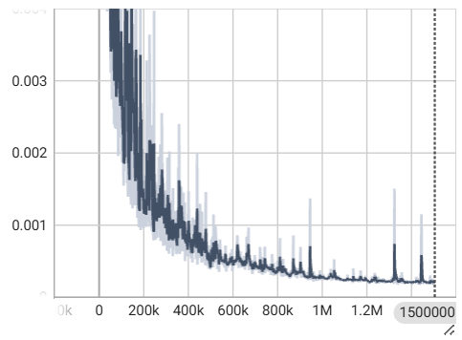
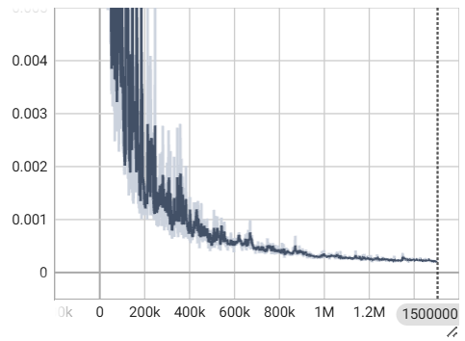
Post Processing (Train)
loss_continuity
loss_momentum_x
loss_momentum_y
loss_momentum_z

Slide 47
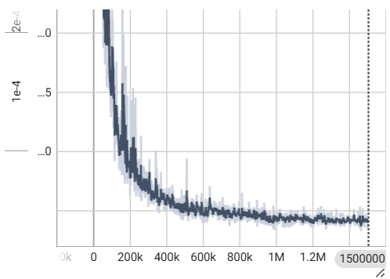
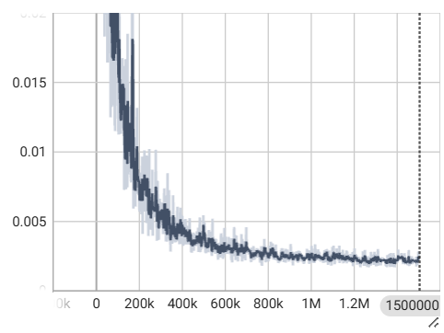
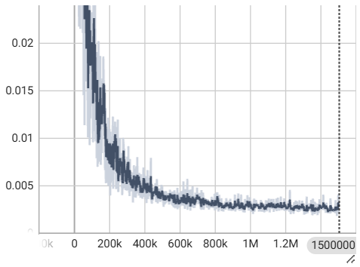
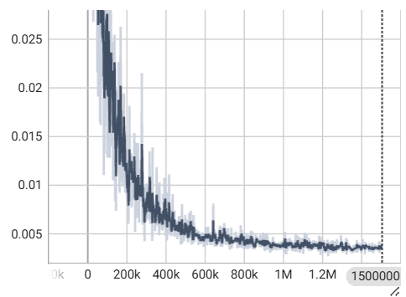
Post Processing (Train)
loss_p
loss_u
loss_v
loss_w

Slide 48
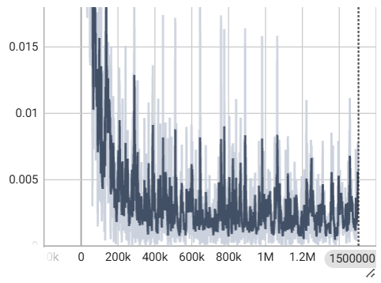
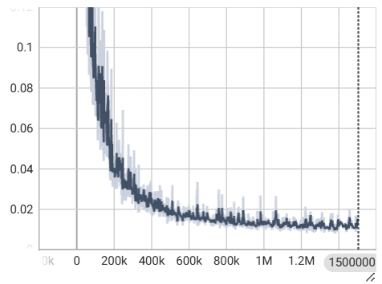
Post Processing (Train)
loss_normal_dot_vel
loss_aggregated

Slide 49
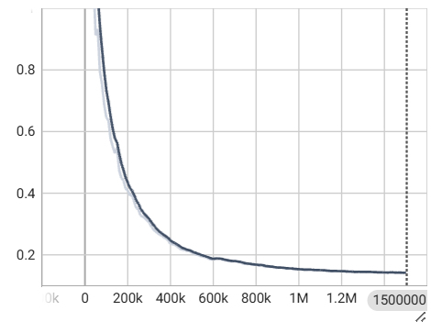
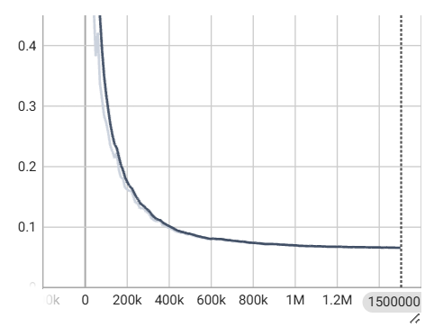
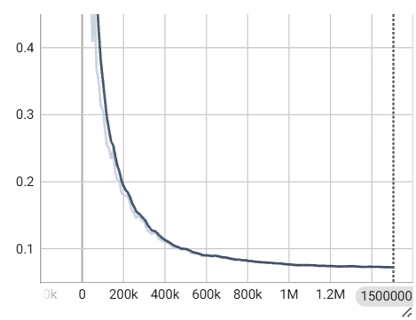
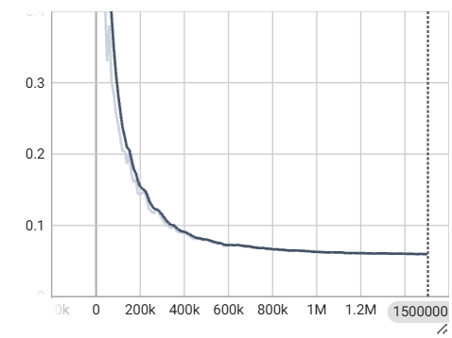
Post Processing (Validators)
L2_error_p
L2_error_u
L2_error_v
L2_error_w

Slide 50
Post Processing
L2_error_p
L2_error_u
L2_error_v
L2_error_w

Slide 51
Post Processing
Inference time = 107.03 sec.
output | L1 | L2 | MSE | RMSE
p | 1.96e-1 | 4.61e-2 | 4.61e-2 | 2.15e-1
u | 8.97e-3 | 2.85e-4 | 2.85e-4 | 1.69e-2
v | 9.64e-3 | 3.73e-4 | 3.73e-4 | 9.64e-3
w | 1.10e-2 | 4.55e-4 | 4.55e-4 | 2.13e-2

Slide 52
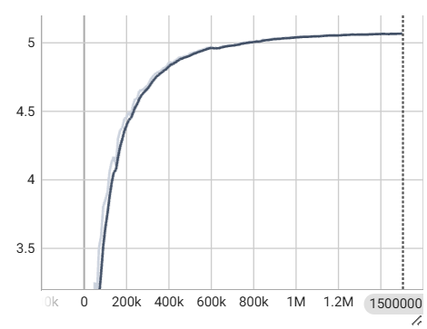
Post Processing (Monitor)
Monitor those randomly sample 16 points on inlet mesh and then trace pressure

Slide 53
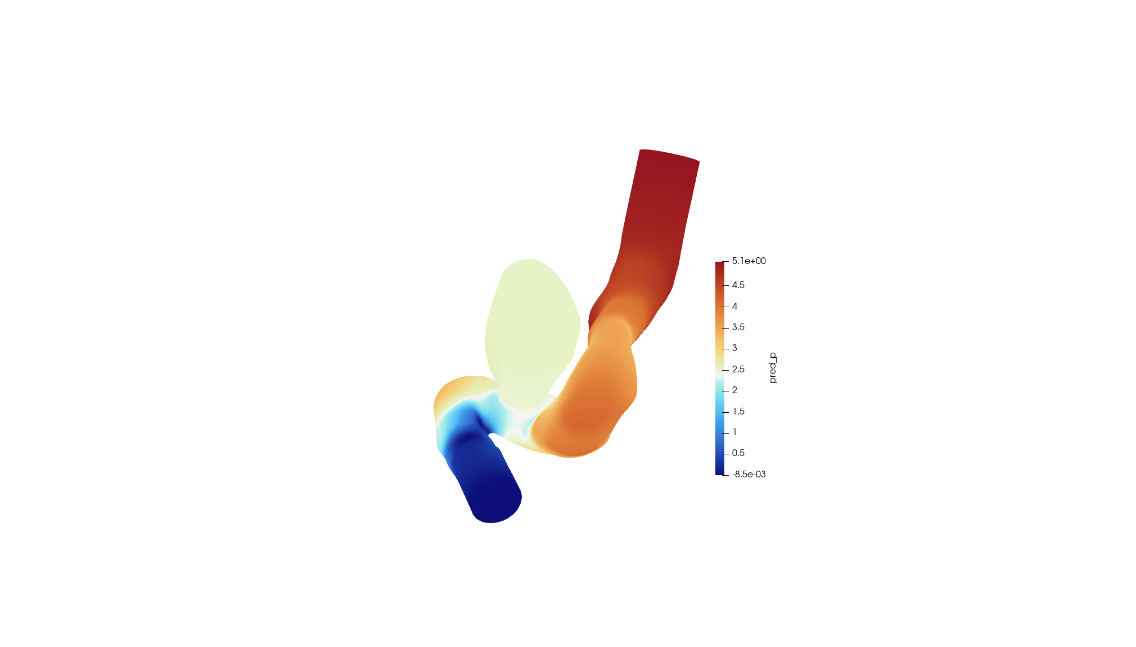

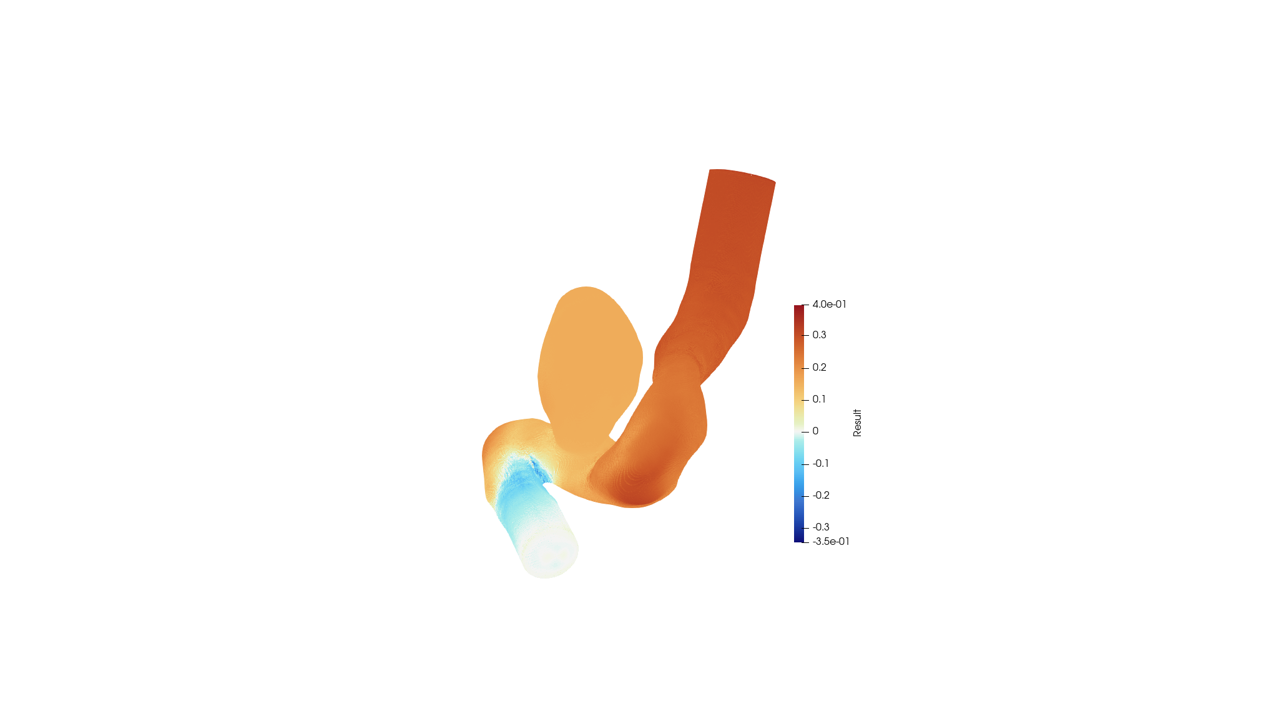
Pressure Posting
Nemo: p
OpenFOAM: p
Error: p

Slide 54
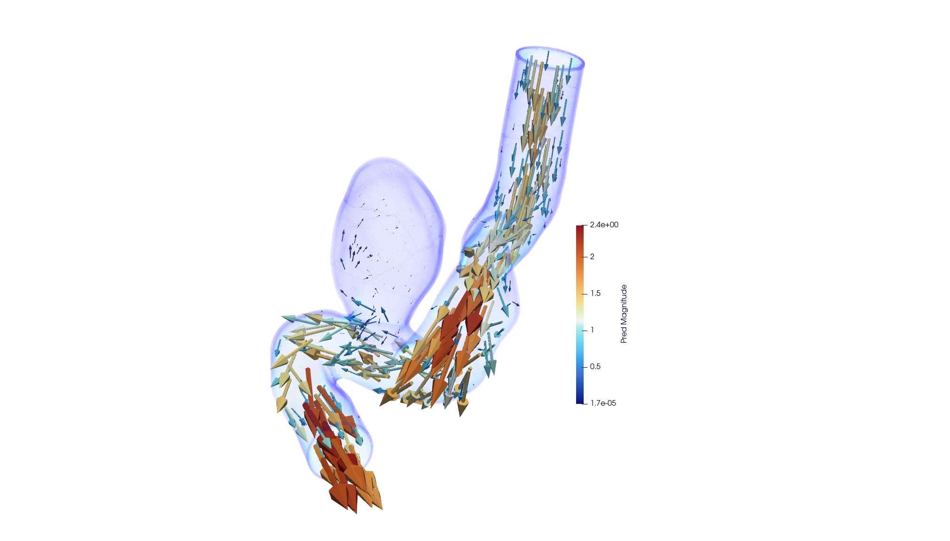
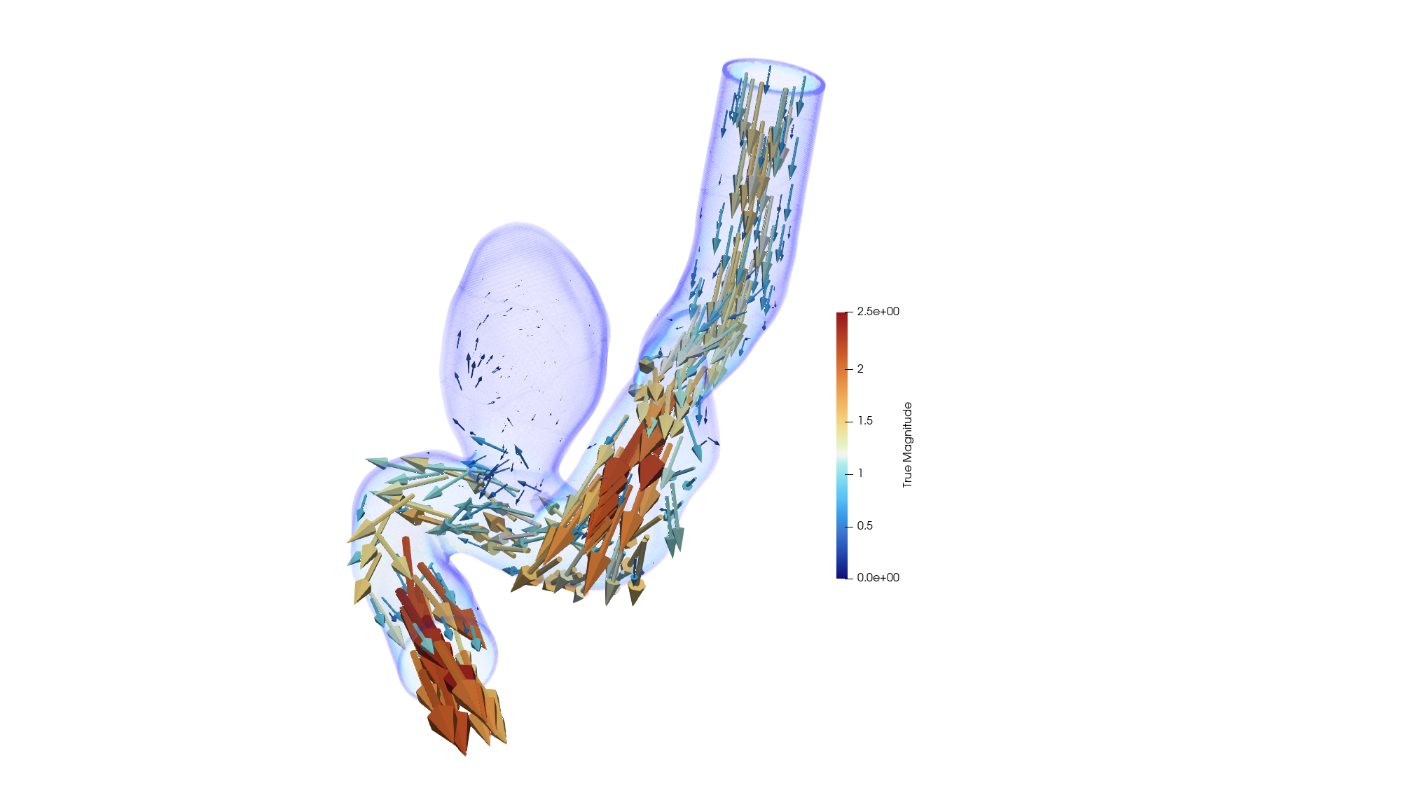
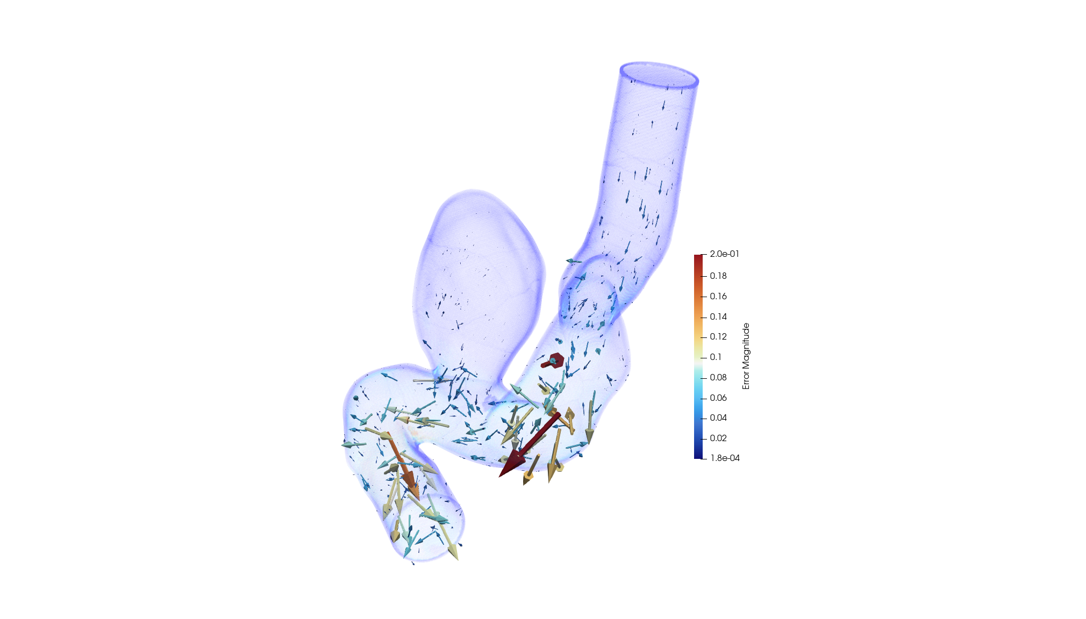
Velocity Posting
Nemo: (u, v, w)
OpenFOAM: (u, v, w)
Error: (u, v, w)

Slide 55
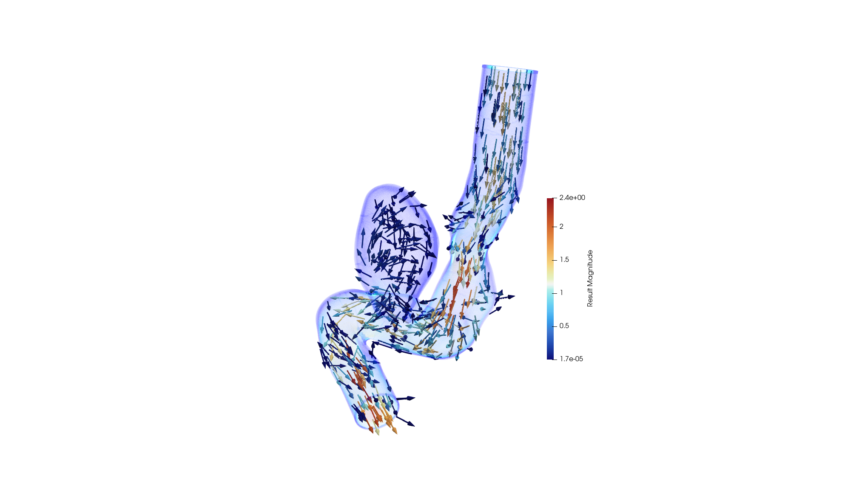
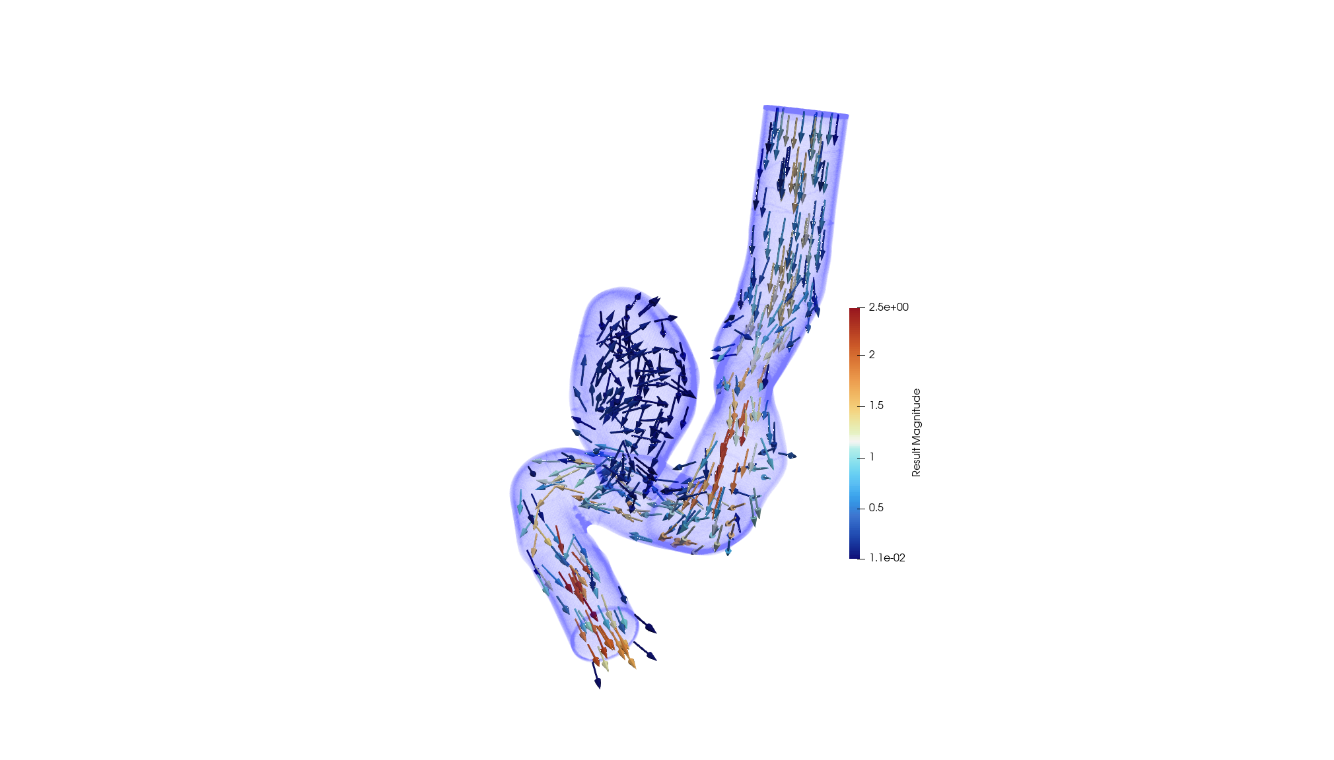
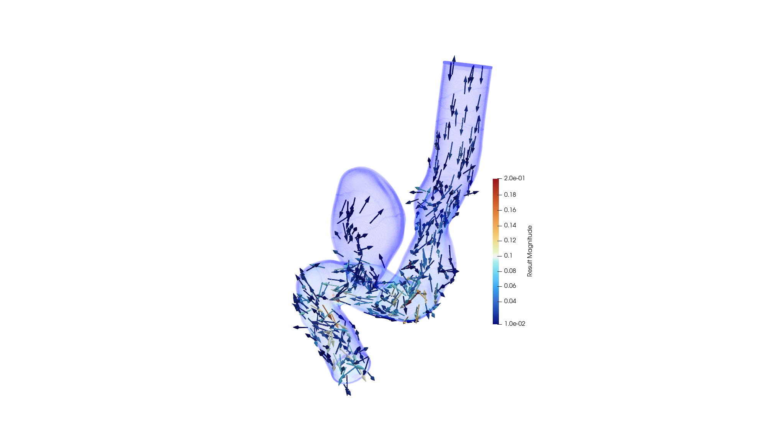
Velocity Posting
Nemo: (u, v, w)
OpenFOAM: (u, v, w)
Error: (u, v, w)

Slide 56
Accelerating the Training of Neural
Network Solvers via Transfer Learning

Slide 57

Transfer Learning
Unlike the traditional solvers, neural network solvers can transfer knowledge across different neural network.
In transfer learning, knowledge from neural network can be reused to train another network for a similar system with slight differences (e.g., geometry).

Slide 58
Transfer Learning
defaults:
……
scheduler:
decay_rate: 0.95
#decay_steps: 15000 # full run
decay_steps: 6000 # TL run
network_dir: "network_checkpoint_target"
initialization_network_dir: "../aneurysm/network_checkpoint_source/"
training:
rec_results_freq: 10000
rec_constraint_freq: 50000
#max_steps: 1500000 # full run
max_steps: 400000 # TL run
batch_size:
……
Set initialize_network_dir to the source model network checkpoint.

Slide 59
Transfer Learning
defaults:
……
scheduler:
decay_rate: 0.95
#decay_steps: 15000 # full run
decay_steps: 6000 # TL run
network_dir: "network_checkpoint_target"
initialization_network_dir: "../aneurysm/network_checkpoint_source/"
training:
rec_results_freq: 10000
rec_constraint_freq: 50000
#max_steps: 1500000 # full run
max_steps: 400000 # TL run
batch_size:
……
In transfer learning, use fewer iterations, and faster decay since the source model is fine-tuned instead of trained from scratch.

Slide 60
Demo

Slide 61
Install physicsnemo-sym
Before starting with aneurysm example, you need to install the following components:
vscode
WSL2
Docker
NVIDIA Container Toolkit
physicsnemo docker image in WSL
Download physicsnemo-sym package in WSL
$ git clone https://github.com/NVIDIA/physicsnemo-sym.git
cd to physicsnemo-sym/examples/aneurysm/
$ cd physicsnemo-sym/examples/aneurysm/

Slide 62
Download STL Object
Now, you are currently in the darcy file, and terminal just look like
/mnt/c/Users/User/physicsnemo-sym/examples/aneurysm$ …
Open vscode (optional)
$ code .
Download STL file and validation data
https://catalog.ngc.nvidia.com/orgs/nvidia/teams/physicsnemo/resources/physicsnemo_sym_examples_supplemental_materials/files

Slide 63
Launch Docker Container
Back to WSL terminal
Mount the current directory into the container's /workspace directory
$ docker run -p 7007:7007 --rm --name [container_name] -d --gpus all --shm-size=8g --ulimit memlock=-1 --ulimit stack=67108864 -v ${PWD}:/workspace -it nvcr.io/nvidia/physicsnemo/physicsnemo:25.03 bash
Warning : Before executing this command, your localhost 7007 port must be unused. Using this command to check if 7007 port is in use:
$ docker ps -a --format "table {{.ID}}\t{{.Names}}\t{{.Ports}}" | grep 7007
Enter container
$ docker exec -it [container_name] bash

Slide 64

Running
View all file in /worksapce (find aneurysm.py)
$ ls -l
Training
$ python aneurysm.py

Slide 65
Post Procssing
Open tensorboard
$ tensorboard --logdir=./ --port=7007
Link to 127.0.0.1:7007 on your browser

Slide 66
Appendix

Slide 67
How to post vector field

Slide 68

Calculator
Import validator.vtp and apply
Ctrl + space → Calculator
Create velocity vector: iHat*true_u+jHat*true_v+kHat*true_w

Slide 69

Calculator
Apply calculator and select “Result”

Slide 70

Glyph
Ctrl + space → Glyph
Setup scale array to “Result”
Setup number of sample point

Slide 71
Glyph
Apply glyph
Adjust calculator opacity to 0.005

Slide 72
API

Slide 73
Key
class physicsnemo.sym.key.Key(name, size=1, derivatives=[], base_unit=None, scale=
(0.0,1.0))
Class describing keys used for graph unroll. The most basic key is just a simple string
however you can also add dimension information and even information on how to scale
inputs to networks.
name (str) – String used to refer to the variable (e.g. ‘x’, ‘y’…).
size (int=1) – Dimension of variable.
derivatives (List=[]) – This signifies that this key holds a derivative with respect to that key.
scale ((float, float)) – Characteristic location and scale of quantity: used for normalisation.

Slide 74
Node
class physicsnemo.sym.node.Node(inputs, outputs, evaluate, name='Node', optimize=False)
Base class for all nodes used to unroll computational graph in PhysicsNeMo.
inputs (List[Union[str, Key]]) – Names of inputs to node. For example, inputs=[‘x’, ‘y’].
outputs (List[Union[str, Key]]) – Names of outputs to node. For example, inputs=[‘u’, ‘v’, ‘p’].
evaluate (Pytorch Function) – A pytorch function that takes in a dictionary of tensors whose keys are the above inputs.
name (str) – Name of node for print statements and debugging.
optimize (bool) – If true then any trainable parameters contained in the node will be optimized by the Trainer.

Slide 75
IntegralBoundaryConstraint
physicsnemo.sym.domain.constraint.continuous.IntegralBoundaryConstraint(nodes: List
[Node], geometry: Geometry, outvar: Dict[str, Union[int, float, Basic]], batch_size: int,
integral_batch_size: int, criteria: Optional[Union[Basic, Callable]] = None, lambda_weighting:
Dict[str, Union[int, float, Basic]] = None, parameterization: Optional[Parameterization] =
None, fixed_dataset: bool = True, batch_per_epoch: int = 100, quasirandom: bool = False,
num_workers: int = 0, loss: Loss = IntegralLossNorm(), shuffle: bool = True)
Integral Constraint applied to boundary/perimeter/surface of geometry. For example, in 3D
this will create a constraint on the surface of the given geometry.
inputs (List[Union[str, Key]]) – Names of inputs to node. For example, inputs=[‘x’, ‘y’].
nodes (List[Node]) – List of PhysicsNeMo Nodes to unroll graph with.
geometry (Geometry) – PhysicsNeMo Geometry to apply the constraint with.
outvar (Dict[str, Union[int, float, sp.Basic]]) – A dictionary of SymPy Symbols/Expr, floats or int. This is used to describe the constraint. For example, outvar={‘u’: 0} would specify the integral of ‘u’ to be zero.

Slide 76
IntegralBoundaryConstraint
physicsnemo.sym.domain.constraint.continuous.IntegralBoundaryConstraint(nodes: List
[Node], geometry: Geometry, outvar: Dict[str, Union[int, float, Basic]], batch_size: int,
integral_batch_size: int, criteria: Optional[Union[Basic, Callable]] = None, lambda_weighting:
Dict[str, Union[int, float, Basic]] = None, parameterization: Optional[Parameterization] =
None, fixed_dataset: bool = True, batch_per_epoch: int = 100, quasirandom: bool = False,
num_workers: int = 0, loss: Loss = IntegralLossNorm(), shuffle: bool = True)
nodes (List[Node]) – List of PhysicsNeMo Nodes to unroll graph with.
criteria (Union[sp.basic, True]) – SymPy criteria function specifies to only integrate areas that satisfy this criteria. For example, if criteria=sympy.Symbol(‘x’)>0 then only areas that have positive ‘x’ values will be integrated.
lambda_weighting (Dict[str, Union[int, float, sp.Basic]] = None) – The weighting of the constraint. For example, lambda_weighting={‘lambda_u’: 2.0} would weight the integral constraint by 2.0.
parameterization (Union[Parameterization, None]) – This allows adding parameterization or additional inputs.

Slide 77
IntegralBoundaryConstraint
physicsnemo.sym.domain.constraint.continuous.IntegralBoundaryConstraint(nodes: List
[Node], geometry: Geometry, outvar: Dict[str, Union[int, float, Basic]], batch_size: int,
integral_batch_size: int, criteria: Optional[Union[Basic, Callable]] = None, lambda_weighting:
Dict[str, Union[int, float, Basic]] = None, parameterization: Optional[Parameterization] =
None, fixed_dataset: bool = True, batch_per_epoch: int = 100, quasirandom: bool = False,
num_workers: int = 0, loss: Loss = IntegralLossNorm(), shuffle: bool = True)
fixed_dataset (bool = True) – If True then the points sampled for this constraint are done right when initialized and fixed. If false then the points are continually resampled.
batch_per_epoch (int = 100) – If fixed_dataset=True then the total number of integrals generated to apply constraint on is total_nr_integrals=batch_per_epoch*batch_size.
quasirandom (bool = False) – If true then sample the points using the Halton sequence.
num_workers (int) – Number of worker used in fetching data.
loss (Loss) – PhysicsNeMo Loss module that defines the loss type, (e.g. L2, L1, …).

Slide 78
IntegralBoundaryConstraint
physicsnemo.sym.domain.constraint.continuous.IntegralBoundaryConstraint(nodes: List
[Node], geometry: Geometry, outvar: Dict[str, Union[int, float, Basic]], batch_size: int,
integral_batch_size: int, criteria: Optional[Union[Basic, Callable]] = None, lambda_weighting:
Dict[str, Union[int, float, Basic]] = None, parameterization: Optional[Parameterization] =
None, fixed_dataset: bool = True, batch_per_epoch: int = 100, quasirandom: bool = False,
num_workers: int = 0, loss: Loss = IntegralLossNorm(), shuffle: bool = True)
shuffle (bool, optional) – Randomly shuffle examples in dataset every epoch, by default True

Slide 79
PointwiseBoundaryConstraint
physicsnemo.sym.domain.constraint.continuous.PointwiseBoundaryConstraint(nodes: List
[Node], geometry: Geometry, outvar: Dict[str, Union[int, float, Basic]], batch_size: int, criteria
: Optional[Union[Basic, Callable]] = None, lambda_weighting: Dict[str, Union[int, float, Basic]
] = None, parameterization: Optional[Parameterization] = None, fixed_dataset: bool = True,
importance_measure: Optional[Callable] = None, batch_per_epoch: int = 1000, quasirando
m: bool = False, num_workers: int = 0, loss: Loss = PointwiseLossNorm(), shuffle: bool = Tu
e)
Pointwise Constraint applied to boundary/perimeter/surface of geometry. For example, in 3D this will create a constraint on the surface of the given geometry.
nodes (List[Node]) – List of PhysicsNeMo Nodes to unroll graph with.
geometry (Geometry) – PhysicsNeMo Geometry to apply the constraint with.
outvar (Dict[str, Union[int, float, sp.Basic]]) – A dictionary of SymPy Symbols/Expr, floats or int. This is used to describe the constraint. For example, outvar={‘u’: 0} would specify ‘u’ to be zero everywhere on the constraint.
batch_size (int) – Batch size used in training.

Slide 80
PointwiseBoundaryConstraint
physicsnemo.sym.domain.constraint.continuous.PointwiseBoundaryConstraint(nodes: List
[Node], geometry: Geometry, outvar: Dict[str, Union[int, float, Basic]], batch_size: int, criteria
: Optional[Union[Basic, Callable]] = None, lambda_weighting: Dict[str, Union[int, float, Basic]
] = None, parameterization: Optional[Parameterization] = None, fixed_dataset: bool = True,
importance_measure: Optional[Callable] = None, batch_per_epoch: int = 1000, quasirando
m: bool = False, num_workers: int = 0, loss: Loss = PointwiseLossNorm(), shuffle: bool = Tu
e)
criteria (Union[sp.Basic, True]) – SymPy criteria function specifies to only apply constraint to areas that satisfy this criteria. For example, if criteria=sympy.Symbol(‘x’)>0 then only areas that have positive ‘x’ values will have the constraint applied to them.
lambda_weighting (Dict[str, Union[int, float, sp.Basic]] = None) – The spatial pointwise weighting of the constraint. For example, lambda_weighting={‘lambda_u’: 2.0*sympy.Symbol(‘x’)} would apply a pointwise weighting to the loss of 2.0 * x.

Slide 81
PointwiseBoundaryConstraint
physicsnemo.sym.domain.constraint.continuous.PointwiseBoundaryConstraint(nodes: List
[Node], geometry: Geometry, outvar: Dict[str, Union[int, float, Basic]], batch_size: int, criteria
: Optional[Union[Basic, Callable]] = None, lambda_weighting: Dict[str, Union[int, float, Basic]
] = None, parameterization: Optional[Parameterization] = None, fixed_dataset: bool = True,
importance_measure: Optional[Callable] = None, batch_per_epoch: int = 1000, quasirando
m: bool = False, num_workers: int = 0, loss: Loss = PointwiseLossNorm(), shuffle: bool = Tu
e)
parameterization (Union[Parameterization, None], optional) – This allows adding parameterization or additional inputs.
fixed_dataset (bool = True) – If True then the points sampled for this constraint are done right when initialized and fixed. If false then the points are continually resampled.
compute_sdf_derivatives (bool, optional) – Compute SDF derivatives when sampling geometery

Slide 82
PointwiseBoundaryConstraint
physicsnemo.sym.domain.constraint.continuous.PointwiseBoundaryConstraint(nodes: List
[Node], geometry: Geometry, outvar: Dict[str, Union[int, float, Basic]], batch_size: int, criteria
: Optional[Union[Basic, Callable]] = None, lambda_weighting: Dict[str, Union[int, float, Basic]
] = None, parameterization: Optional[Parameterization] = None, fixed_dataset: bool = True,
importance_measure: Optional[Callable] = None, batch_per_epoch: int = 1000, quasirando
m: bool = False, num_workers: int = 0, loss: Loss = PointwiseLossNorm(), shuffle: bool = Tu
e)
importance_measure (Union[Callable, None] = None) – A callable function that computes a scalar importance measure. This importance measure is then used in the constraint when sampling points. Areas with higher importance are sampled more frequently according to Monte Carlo importance sampling, https://en.wikipedia.org/wiki/Monte_Carlo_integration.
batch_per_epoch (int = 1000) – If fixed_dataset=True then the total number of points generated to apply constraint on is total_nr_points=batch_per_epoch*batch_size.
quasirandom (bool = False) – If true then sample the points using the Halton sequence.

Slide 83
PointwiseBoundaryConstraint
physicsnemo.sym.domain.constraint.continuous.PointwiseBoundaryConstraint(nodes: List
[Node], geometry: Geometry, outvar: Dict[str, Union[int, float, Basic]], batch_size: int, criteria
: Optional[Union[Basic, Callable]] = None, lambda_weighting: Dict[str, Union[int, float, Basic]
] = None, parameterization: Optional[Parameterization] = None, fixed_dataset: bool = True,
importance_measure: Optional[Callable] = None, batch_per_epoch: int = 1000, quasirando
m: bool = False, num_workers: int = 0, loss: Loss = PointwiseLossNorm(), shuffle: bool = Tu
e)
num_workers (int) – Number of worker used in fetching data.
loss (Loss) – PhysicsNeMo Loss module that defines the loss type, (e.g. L2, L1, …).
shuffle (bool, optional) – Randomly shuffle examples in dataset every epoch, by default True

Slide 84
PointwiseInteriorConstraint
class physicsnemo.sym.domain.constraint.continuous.PointwiseInteriorConstraint(nodes:
List[Node], geometry: Geometry, outvar: Dict[str, Union[int, float, Basic]], batch_size: int,
bounds: Dict[Basic, Tuple[float, float]] = None, criteria: Optional[Union[Basic, Callable]] =
None, lambda_weighting: Dict[str, Union[int, float, Basic]] = None, parameterization: Optiona
l[Parameterization] = None, fixed_dataset: bool = True, compute_sdf_derivatives: bool =
False, importance_measure: Optional[Callable] = None, batch_per_epoch: int = 1000, quasi
random: bool = False, num_workers: int = 0, loss: Loss = PointwiseLossNorm(), shuffle:
bool = True)
Pointwise Constraint applied to interior of geometry. For example, in 3D this will create a constraint on the interior volume of the given geometry.
nodes (List[Node]) – List of PhysicsNeMo Nodes to unroll graph with.
geometry (Geometry) – PhysicsNeMo Geometry to apply the constraint with.
outvar (Dict[str, Union[int, float, sp.Basic]]) – A dictionary of SymPy Symbols/Expr, floats or int. This is used to describe the constraint. For example, outvar={‘u’: 0} would specify ‘u’ to be zero everywhere in the constraint.

Slide 85
PointwiseInteriorConstraint
class physicsnemo.sym.domain.constraint.continuous.PointwiseInteriorConstraint(nodes:
List[Node], geometry: Geometry, outvar: Dict[str, Union[int, float, Basic]], batch_size: int,
bounds: Dict[Basic, Tuple[float, float]] = None, criteria: Optional[Union[Basic, Callable]] =
None, lambda_weighting: Dict[str, Union[int, float, Basic]] = None, parameterization: Optiona
l[Parameterization] = None, fixed_dataset: bool = True, compute_sdf_derivatives: bool =
False, importance_measure: Optional[Callable] = None, batch_per_epoch: int = 1000, quasi
random: bool = False, num_workers: int = 0, loss: Loss = PointwiseLossNorm(), shuffle:
bool = True)
batch_size (int) – Batch size used in training.
bounds (Dict[sp.Basic, Tuple[float, float]] = None) – Bounds of the given geometry, (e.g. `bounds={sympy.Symbol(‘x’): (0, 1), sympy.Symbol(‘y’): (0, 1)}).
criteria (Union[sp.basic, True]) – SymPy criteria function specifies to only apply constraint to areas that satisfy this criteria. For example, if criteria=sympy.Symbol(‘x’)>0 then only areas that have positive ‘x’ values will have the constraint applied to them.

Slide 86
PointwiseInteriorConstraint
class physicsnemo.sym.domain.constraint.continuous.PointwiseInteriorConstraint(nodes:
List[Node], geometry: Geometry, outvar: Dict[str, Union[int, float, Basic]], batch_size: int,
bounds: Dict[Basic, Tuple[float, float]] = None, criteria: Optional[Union[Basic, Callable]] =
None, lambda_weighting: Dict[str, Union[int, float, Basic]] = None, parameterization: Optiona
l[Parameterization] = None, fixed_dataset: bool = True, compute_sdf_derivatives: bool =
False, importance_measure: Optional[Callable] = None, batch_per_epoch: int = 1000, quasi
random: bool = False, num_workers: int = 0, loss: Loss = PointwiseLossNorm(), shuffle:
bool = True)
lambda_weighting (Dict[str, Union[int, float, sp.Basic]] = None) – The spatial pointwise weighting of the constraint. For example, lambda_weighting={‘lambda_u’: 2.0*sympy.Symbol(‘x’)} would apply a pointwise weighting to the loss of 2.0 * x.
parameterization (Union[Parameterization, None] = {}) – This allows adding parameterization or additional inputs.
fixed_dataset (bool = True) – If True then the points sampled for this constraint are done right when initialized and fixed. If false then the points are continually resampled.

Slide 87
PointwiseInteriorConstraint
class physicsnemo.sym.domain.constraint.continuous.PointwiseInteriorConstraint(nodes:
List[Node], geometry: Geometry, outvar: Dict[str, Union[int, float, Basic]], batch_size: int,
bounds: Dict[Basic, Tuple[float, float]] = None, criteria: Optional[Union[Basic, Callable]] =
None, lambda_weighting: Dict[str, Union[int, float, Basic]] = None, parameterization: Optiona
l[Parameterization] = None, fixed_dataset: bool = True, compute_sdf_derivatives: bool =
False, importance_measure: Optional[Callable] = None, batch_per_epoch: int = 1000, quasi
random: bool = False, num_workers: int = 0, loss: Loss = PointwiseLossNorm(), shuffle:
bool = True)
importance_measure (Union[Callable, None] = None) – A callable function that computes a scalar importance measure. This importance measure is then used in the constraint when sampling points. Areas with higher importance are sampled more frequently according to Monte Carlo importance sampling, https://en.wikipedia.org/wiki/Monte_Carlo_integration.
batch_per_epoch (int = 1000) – If fixed_dataset=True then the total number of points generated to apply constraint on is total_nr_points=batch_per_epoch*batch_size.

Slide 88
PointwiseInteriorConstraint
class physicsnemo.sym.domain.constraint.continuous.PointwiseInteriorConstraint(nodes:
List[Node], geometry: Geometry, outvar: Dict[str, Union[int, float, Basic]], batch_size: int,
bounds: Dict[Basic, Tuple[float, float]] = None, criteria: Optional[Union[Basic, Callable]] =
None, lambda_weighting: Dict[str, Union[int, float, Basic]] = None, parameterization: Optiona
l[Parameterization] = None, fixed_dataset: bool = True, compute_sdf_derivatives: bool =
False, importance_measure: Optional[Callable] = None, batch_per_epoch: int = 1000, quasi
random: bool = False, num_workers: int = 0, loss: Loss = PointwiseLossNorm(), shuffle:
bool = True)
quasirandom (bool = False) – If true then sample the points using the Halton sequence.
num_workers (int) – Number of worker used in fetching data.
loss (Loss) – PhysicsNeMo Loss module that defines the loss type, (e.g. L2, L1, …).
shuffle (bool, optional) – Randomly shuffle examples in dataset every epoch, by default True

Slide 89
PointwiseValidator
class physicsnemo.sym.domain.validator.continuous.PointwiseValidator(nodes: List[Node],
invar: Dict[str, array], true_outvar: Dict[str, array], batch_size: int = 1024, plotter: ValidatorPl
otter = None, requires_grad: bool = False)
Pointwise Validator that allows walidating on pointwise data
nodes (List[Node]) – List of PhysicsNeMo Nodes to unroll graph with.
invar (Dict[str, np.ndarray (N, 1)]) – Dictionary of numpy arrays as input.
true_outvar (Dict[str, np.ndarray (N, 1)]) – Dictionary of numpy arrays used to validate against validation.
batch_size (int, optional) – Batch size used when running validation, by default 1024
plotter (ValidatorPlotter) – PhysicsNeMo plotter for showing results in tensorboard.
requires_grad (bool = False) – If automatic differentiation is needed for computing results.

Slide 90
PointwiseMonitor
class physicsnemo.sym.domain.monitor.pointwise.PointwiseMonitor(invar, output_names,
metrics, nodes, summary_histograms='off', requires_grad=False)
PointwisePointwise Inferencer that allows inferencing on pointwise data
invar (Dict[str, np.ndarray (N, 1)]) – Dictionary of numpy arrays as input.
output_names (List[str]) – List of outputs needed for metric.
metrics (Dict[str, Callable]) – Dictionary of pytorch functions whose input is a dictionary torch tensors whose keys are the output_names. The keys to metrics will be used to label the metrics in tensorboard/csv outputs.
nodes (List[Node]) – List of PhysicsNeMo Nodes to unroll graph with.
summary_histograms (str = "off") – The histograms of all outputs and intermediate results will be monitored and added to tensorboard. Choices are: “off”, “linear” and “log2”, default is “off”.
requires_grad (bool = False) – If automatic differentiation is needed for computing results.

Slide 91
PhysicsNeMoConfig
class physicsnemo.sym.hydra.config.PhysicsNeMoConfig(network_dir: str = '.', initialization_
network_dir: str = '', save_filetypes: str = 'vtk', summary_histograms: str = 'off', jit: bool =
True, jit_use_nvfuser: bool = True, jit_arch_mode: str = 'only_activation', jit_autograd_nodes:
bool = False, cuda_graphs: bool = True, cuda_graph_warmup: int = 20, find_unused_
parameters: bool = False, broadcast_buffers: bool = False, device: str = '', debug: bool =
False, run_mode: str = 'train', arch: Any = '???', models: Any = '???', training: physicsnemo
.sym.hydra.training.TrainingConf = '???', stop_criterion: physicsnemo.sym.hydra.training.
StopCriterionConf = '???', loss: physicsnemo.sym.hydra.loss.LossConf = '???', optimizer:
physicsnemo.sym.hydra.optimizer.OptimizerConf = '???', scheduler: physicsnemo.sym.
hydra.scheduler.SchedulerConf = '???', batch_size: Any = '???', profiler: physicsnemo.
sym.hydra.profiler.ProfilerConf = '???', hydra: Any = <factory>, custom: Any = '???')

Slide 92
Tessellation
class physicsnemo.sym.geometry.tessellation.Tessellation(mesh, airtight=True,
parameterization=<physicsnemo.sym.geometry.parameterization.Parameterization object>)
Constructive Tessellation Module that allows sampling on surface and interior of a tessellated geometry.
mesh (Mesh (numpy-stl)) – A mesh that defines the surface of the geometry.
airtight (bool) – If the geometry is airtight or not. If false sample everywhere for interior.
parameterization (Parameterization) – Parameterization of geometry.

Slide 93
Tessellation
classmethod from_stl(filename, airtight=True, parameterization=<physicsnemo.sym.
geometry.parameterization.Parameterization object>)
Constructive makes mesh from STL file
filename (str) – filename of mesh.
airtight (bool) – If the geometry is airtight or not. If false sample everywhere for interior.
parameterization (Parameterization) – Parameterization of geometry.

Slide 94
NavierStokes
class physicsnemo.sym.eq.pdes.navier_stokes.NavierStokes(nu, rho=1, dim=3, time=True,
mixed_form=False)
Compressible Navier Stokes equations Reference: https://turbmodels.larc.nasa.gov/implementrans.html
nu (float, Sympy Symbol/Expr, str) – The kinematic viscosity. If nu is a str then it is converted to Sympy Function of form nu(x,y,z,t). If nu is a Sympy Symbol or Expression then this is substituted into the equation. This allows for variable viscosity.
rho (float, Sympy Symbol/Expr, str) – The density of the fluid. If rho is a str then it is converted to Sympy Function of form ‘rho(x,y,z,t)’. If ‘rho’ is a Sympy Symbol or Expression then this is substituted into the equation to allow for compressible Navier Stokes. Default is 1.
dim (int) – Dimension of the Navier Stokes (2 or 3). Default is 3.
time (bool) – If time-dependent equations or not. Default is True.
mixed_form (bool) – If True, use the mixed formulation of the Navier-Stokes equations.

Slide 95
NormalDotVec
class physicsnemo.sym.eq.pdes.basic.NormalDotVec(vec=['u', 'v', 'w'])
Normal dot velocity
dim (int) – Dimension of the equations (1, 2, or 3). Default is 3.

Slide 96
Thank you

